Slide 1
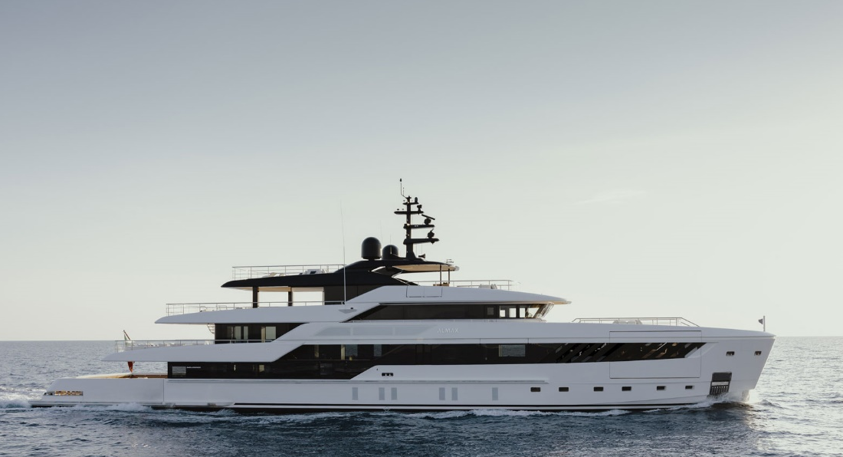
Worldwide Yacht Market Overview
Maxime Georges – BNP Paribas - Jet & YACHT FINANCE
Nice, 18.06.2025
Geneva, 22nd November 2022

Slide 2
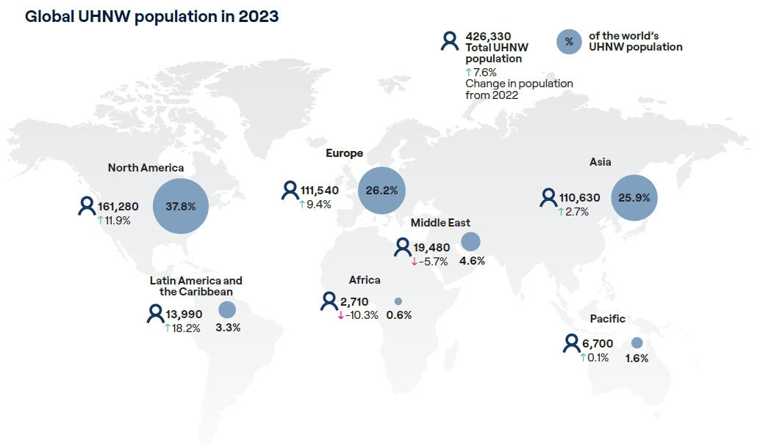
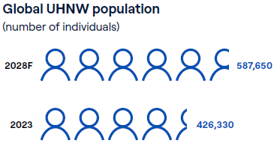
Billionaires and UHNWI: the more, the merrier
5y forecast
Yacht customer base is represented by UHNWI (net worth > $30m) which includes billionaires (net worth >$1bn)
Strong growth of UHNWI in 2023:
426,330 UHNWI in 2023 (+7,6% vs 2022) worth a combined $49,2trn (+7,1% YoY) – average UHNWI net worth $115m
Incl. 3,323 billionaires in 2023 (+4% vs 2022) worth a combined $12,1trn (+9%) – average billionaire’s net worth $3,6bn
>50% of all UHNWI population outside North America and within BNPP’s target markets:
Europe (26,2%) – Asia (25,9%) – Middle East (4,6%)
+38% increase in UHNWI pop
+ $19 trn of newly created wealth
Sources: World Ultra Wealth Report 2024 - Altrata
Notes:
Population number

Slide 3
Owner profile: Mature european market. APAC still offers the most potential while MEA has appetite
DESIRES HIERARCHY
SUPERYACHT
Average LOA per yacht by main BNPP served region:
- Middle East: 64m
- Asia: 57m
- Europe: 51m
PRIVATE JET
SPORTS
CLASSIC CARS
ART COLLECTION
Europe is a very mature market with the highest concentration of superyacht owners relative to the billionaire wealth in value there – due to 2/3 of yacht production comes from IT, NL and DE with more than 50% of global fleet sailing the Med sea in Summer.
Besides North America, APAC has the most opportunities to offer with its second position on the billionaire wealth ranking (27%) not being reflected in yacht ownership (only 10% of superyacht owners are from APAC)
The opposite situation in the Middle East also provides opportunities as the proportion of yacht owners (12,8%) is high compared to the amount of wealth there.
Overall trend on new build (2024-2028) does not show any significant increase by any country in yacht ownership (besides the USA at 29%)
Sources: The State of Yachting 2025 & BNPP internal report
Notes:
Yachts 40m+
Wealth of billionaires is 14 trillions in 2024 (USD)

Slide 4
Billionaires hobbies: Where are they likely to spend their money?
Of 3,323 billionaires in 2023 – 87% men – 90% >50yo
Appeal for jet (35,9%) and yacht (13,8%) assets is strong amongst men billionaires
But mostly predominant with older generations (>50)
New gen of bilionaires (<50) incl. those inheriting generational wealth favor travelling and technology
Higher consideration for experiences (travel) vs possessions
$6,3trn baby boomer (>70) wealth transfer over next 15 years
Will new generations care about yachting/jet ownership?
Can boating be a vessel for philanthropy?
Do new generations favor experiences vs ownership?
Top 5 billionaire hobbies by age
Sources: Billionaire Census 2023 & 2024 - Altrata
Notes:
utilisation de l’actif change – ownership was important but changement vers experience (fractional ownership, chartering)

Slide 5
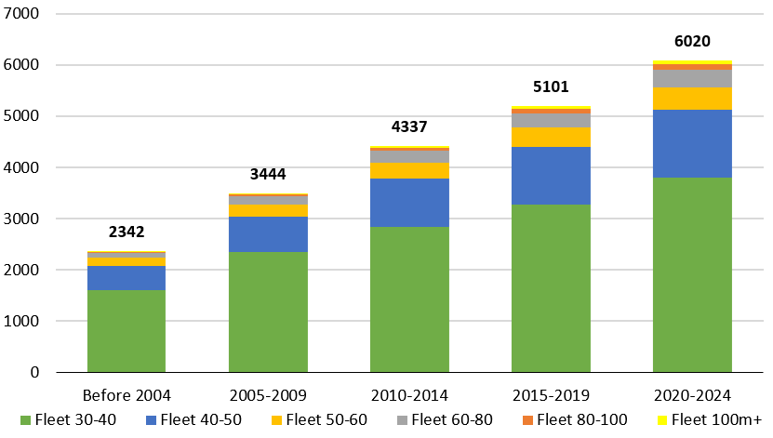
Global Fleet: Healthy growth over last 20 years
A STEADILY GROWING FLEET IN NUMBERS…
+~900
+~800
2,6x
+~900
+~1100
The superyacht fleet has been almost multiplied three times over the last twenty years, from 2342 to 6020 vessels in 2024
***
# of active shipyards
250
247
171
148
The average age of the fleet went from 19 years pre-2004 to 21 years in 2024 – vs average useful life duration of 25/30 years
Source: Superyacht Times - The state of yachting 2024 & SuperYacht Times IQ 12/2024

Slide 6
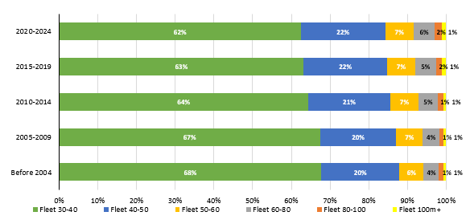
Global Fleet: Slowly but clearly gaining in size
AND IN SIZE…
62% of the global fleet is in the 30-40m LOA, down from 68% pre-2004 as larger yachts (60m and above) fleet growth over past 20 years (CAGR +7%) has been above market average
Current in build projects less focused on the 30-40m (40% vs 62% global fleet) with trend towards larger yachts
The average LOA (m) of a 30m+ superyacht is 41,5m in 2024 (47,9m in build) vs 39,8m (+4,3%) 20 years ago
The average volume (GT) of a 30m+ superyacht is 468 GT in 2024 (735 GT in build) vs 362.1 GT (+30%) in 2004
Only 5% of in build are sailing yachts (vs 15% of current fleet)
Source: Superyacht Times - The state of yachting 2024 & SuperYacht Times IQ 12/2024

Slide 7
Segment Analysis – Main Takeaways
30-40m losing market share to 40-50m which is only segment resilient in terms of sale
50-80m sales of both new and secondhand have dropped YoY
100+m CAGR over 20 year is highest of all segment (+6,79%)
100+m completions have equaled those of 80-100m over past 5 years, wondering what the future can be for the 80-100m segment (increased involvement level of turkish shipyards there)
Segments have their experts – Italian’s Azimut-Benetti is only shipyard active (e.g. Benetti) on all but one segment (80-100m)

Slide 8
Global Fleet: Completions projected to drop in next 5 years
Sales boom
TAKE AWAYS:
Average growth of construction book for 2020-2024 period (7,5%) in line with overall growth of fleet (7,6%)
623 in build only (on hold excl.) as of January 2025 (-5.3% YoY)
Since 2020 – deliveries at year end represent about 34% of in build portfolio at year start
For next 5 years, JYF expectations are for deliveries to drop to 2020/2021 levels as new sales order of 30+m yachts have reached pre-covid levels in 2024
Source: Superyacht Times - The state of yachting 2024

Slide 9
Yacht Market Transactions: market slowing down
Avg LOA sold (m)
VALUE RESILIENCY AS # of TRANSACTIONS DECREASE…
Since a high in 2021 (caused by Covid-19), annual transactions have returned to pre-covid levels (avg 500 a year) but combined sales value have remained resilient
2023 & 2024 saw an increase in total combined sales values while transaction #s went down.
63% of transactions in 2024 were for secondhand yachts
41,9
42,8
42,4
42,5
AS PERCENTAGE OF FLEET AVAILABLE FOR SALE DECREASES
Drop in transactions is partly due to a drop in average secondhand yacht for sale vs segment fleet over the years…
…and new order sales
Source: SYT IQ 01/2025
Notes:
Market slowing down on both sides. Transactions down but values not going down as availability of yachts is more limited

Slide 10
Yacht Market Transactions: Values up overall but volatile
…SETTING UP THE MARKET IN FAVOR OF SELLERS
Average transaction price (new & secondhand) ~+50% in 5 years to ~€18m in 2024.
Average price per gross tonnage (new & secondhand) also increased steadily from €28k/GT in 2020 to €38k/GT in 2024 (+36%)
average asking prices per GT evolution over 2020-2024 was higher on secondhand market (+39%) than new (+26%)
Inflation, supply chain constraints from smaller # of shipyard and lower availability of secondhand market the main culprits?
Source: SYT IQ 01/2025
Notes:
+39% K€/GT 2020-2024 secondhand vs + 26% new

Slide 11
Liquidity analysis: Not quite fast but quicker
SMALLER YACHTS QUICKER TO SELL
TAKE AWAYS:
20 months average Time on Market for new and secondhand yachts sold over the past 5 year appears high but doesn’t consider owners’ trend to put yachts on market for a long time at unrealistic prices – i.e. currently 18% of global fleet >30m is technically for sale…
…and excludes new yachts sold off market
Average TOM has decreased by ~8 months to 18 months between 2020 and 2024 (excl. 100m+ for which data is lacking)
Source: Superyacht Times IQ – February 2025

Slide 12
Main take aways
UHNWI population keeps growing
MEA and ASIA showing most promise
New generation of UHNWI starting to appear with new interests
1
In 2024, the superyacht operating fleet reached >6,000
Inflated by the highest completions in 15 years from Covid-19 sales boom of 2021
New order sales book down to pre-covid levels hinting at slower growth pace for next 5 years
2
Fleet mix is slowly changing with 40-50m, 100m+ gaining the most over past 20 years
30-40m only segment losing market share
100+m segment outperforming 80-100m
3
Market slowing down to pre-covid levels except prices are up and TOM is down
Low inventory rotation at ~10% and only 17% of secondhand yachts for sale
- 8 months average TOM to 16 months
Average asking prices up 50% since 2020 but higher average adjustments (7,2%)
4

Slide 13
Q&A
Maxime Georges
Credit Advisor - Jet & Yacht Finance
Wealth Management
Esplanade de Pont-Rouge 9A, 1211 Geneva 26, Switzerland
Phone: +41 58 212 21 14 | Mob: +41 79 901 58 63
Mail: maxime.georges@bnpparibas.com

