Slide 1
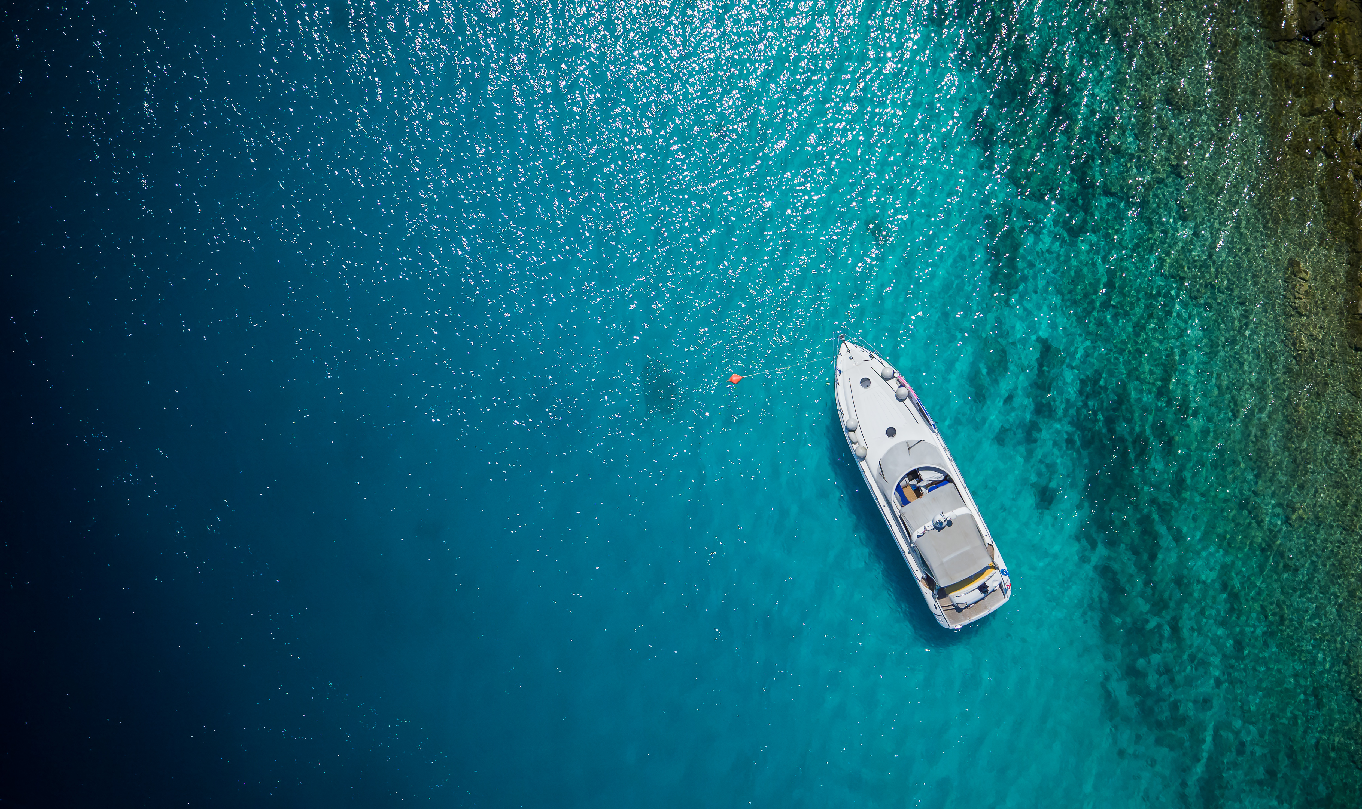
ISYBA at ECPY Symposium:
Anchorage and Regulation in Italy
The Italian Ship & Yacht Brokers Association (ISYBA)
presents its perspective on anchorage regulations and Posidonia
protection in Italian waters.
CHARITY CHEAH
Head of International Brand Development & Relations
ISYBA — Italian Ship & Yacht Brokers Association
Notes:
Good morning, ladies and gentlemen.
My name is Charity Cheah, and I am the Head of International Brand Development & Relations at ISYBA — the Italian Ship & Yacht Brokers Association. Italy’s national association of licensed yacht brokers founded in Milan since 1997
It is a true honour to be here this morning alongside such distinguished guests and to be part of this meaningful dialogue organized by ECPY.
After the excellent insights we’ve heard today I would like to share a complementary perspective on : Anchorage Regulations and Posidonia protection in Italian waters.

Slide 2
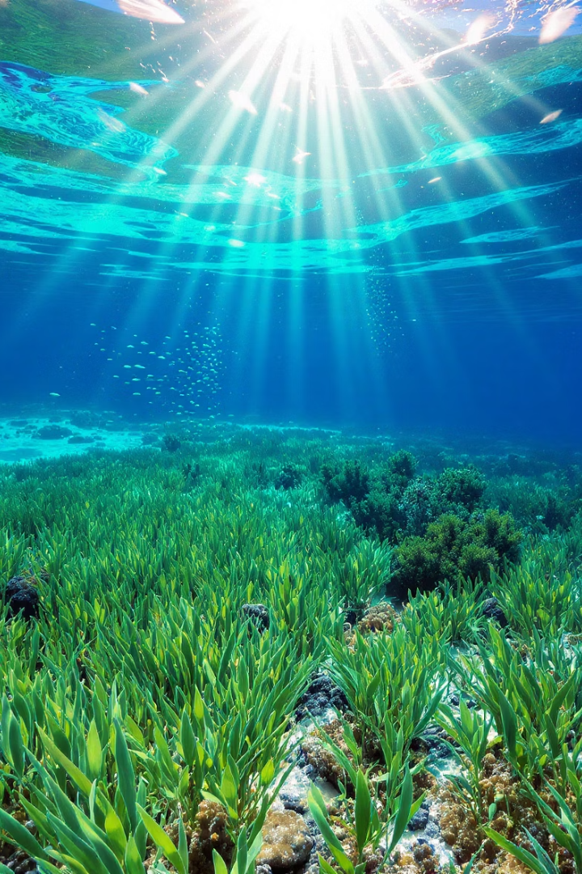
The Protection of Posidonia in EU Law
Posidonia oceanica: protected under EU Directive 92/43/EEC ("Habitats Directive")
Implemented in Italy via Presidential Decree No. 357 (1997)
Also protected under Bern Convention (1979) & Barcelona Convention (1995)
These international agreements provide additional layers
of protection
Designated as a priority habitat critical to Mediterranean
biodiversity
Vital for carbon absorption, water purification, and coastal
protection
Notes:
The legal protection of Posidonia is rooted in multiple overlapping EU and international agreements. In Italy, the Habitats Directive was transposed in 1997, formally recognizing Posidonia meadows as strictly protected habitats. These meadows play a vital role in carbon absorption, water purification, and coastal protection. Italy fully recognizes their environmental significance — but translating this into coherent, navigable boating regulations remains our shared challenge.

Slide 3
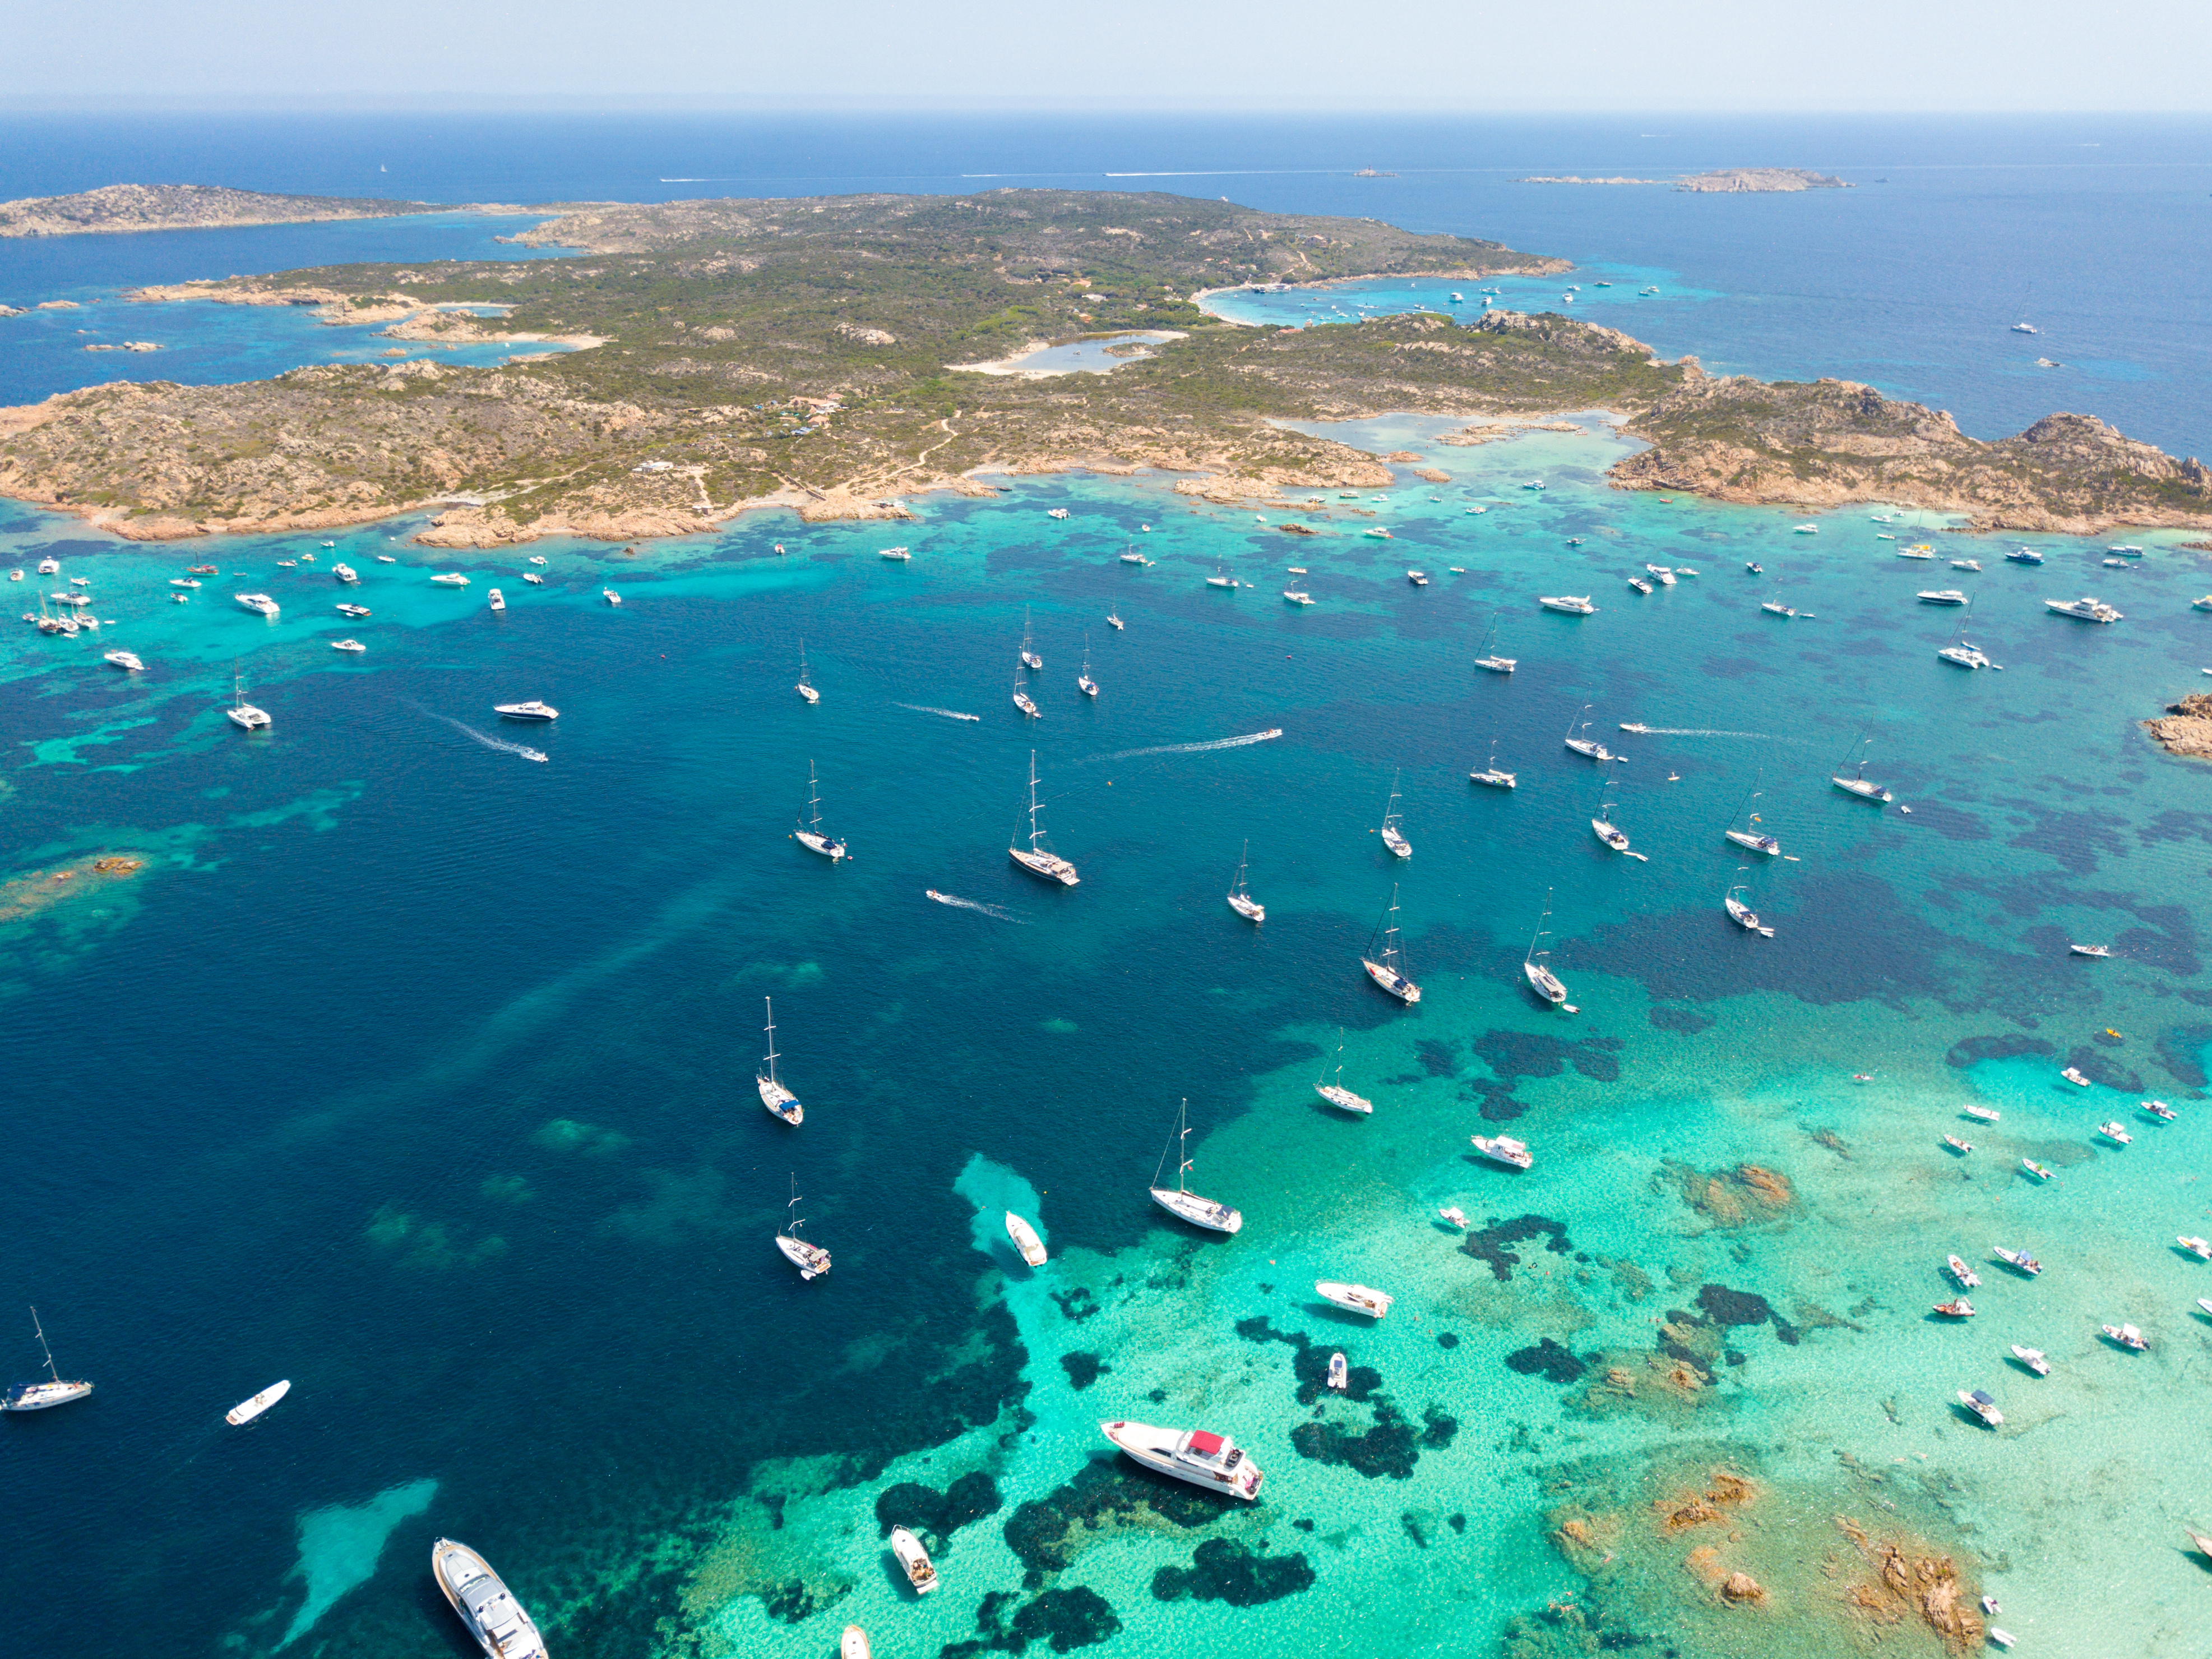
ASPIM / SPAMI Areas
Specially Protected Areas of Mediterranean Importance
ASPIM/SPAMI areas under Barcelona Convention
Managed via UNEP's Regional Activity Centre for Specially Protected Areas
39 Mediterranean ASPIMs — 11 located in Italy
1. Portofino
7. Porto Cesareo
2. Egadi Islands
8. Capo Caccia – Isola Piana
9. Capo Carbonara
3. Tavolara –
Punta Coda Cavallo
10. Sinis Peninsula – Mal di Ventre
4. Punta Campanella
11. Miramare
5. Plemmirio
6. Torre Guaceto
Notes:
ASPIM status offers global environmental recognition, but also stricter requirements for habitat monitoring and protection. Each site is required to conduct ongoing biodiversity assessments to maintain its ASPIM designation. Italy proudly hosts 11 such sites — but this also means boaters must navigate highly localized, site-specific regulations when cruising Italian waters.

Slide 4
Fragmentation of Italian Anchorage Regulations
Enforcement Inconsistency
Varies dramatically between municipalities
Local Bans
E.g. new protected zone at Capri (Faraglioni, 2025)
"Leopard Spot" Protections
Highly fragmented between protected & unregulated areas
No Unified National Legislation
Italy lacks unified national anchorage legislation
Notes:
Unlike some EU neighbors, Italy has no single anchorage law covering its entire coastline. This creates a confusing mosaic where certain areas are heavily protected while others are practically lawless. As an example, this year Capri introduced major new restrictions around its iconic Faraglioni coastline. Without national harmonization, such sudden changes create uncertainty for captains, agents, and charter operators.

Slide 5
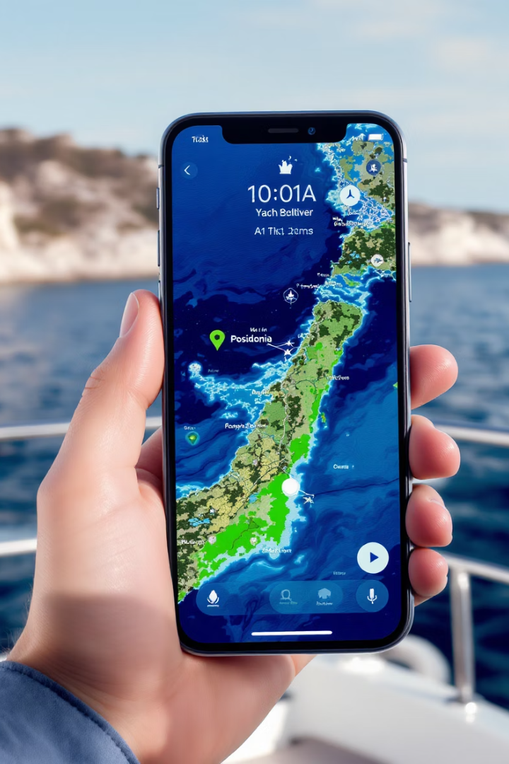
The DONIA App: a Practical Tool
Seabed Mapping
Depth Information
Regulations Access
Shows real-time anchorage data and identifies Posidonia-free zones for safe anchoring
Provides critical depth data for safe navigation and anchoring
Includes local ordinances and protected area boundaries
Italian Integration
Currently underutilized in Italy → opportunity to expand national integration
Notes:
Technology offers part of the solution. The DONIA app gives boaters seabed information and helps prevent unintentional damage to Posidonia. However, its national coverage in Italy remains incomplete. Greater institutional support for tools like DONIA could transform local enforcement from reactive penalties into proactive prevention — protecting both nature and the yachting economy.

Slide 6
The EU Need for Harmonization
Habitat Protection
Sustainable Yachting
Preserving Posidonia and other critical marine ecosystems
Supporting recreational boating while protecting nature
Mediterranean Yachting Charter
Economic Growth
Current fragmentation slows sector growth & foreign investment
Joint EU-level representation and standardized digital access
Notes:
The situation with anchoring is just one chapter in a larger EU-wide inconsistency across yachting regulations: tax, charter licenses, leasing rules — all vary country by country. Lack of uniformity hampers sector growth. EU-wide anchorage standards could be the first step in building legal stability for the industry while ensuring environmental protection.

Slide 7
Contact Us
Phone
info@isyba.it
+39 3939091561
Thank You
Website
www.isyba.it
Notes:
Conclusion
As we’ve seen, anchorage regulation is no longer a matter confined within national waters — it is part of a wider Mediterranean responsibility that we all share.
Italy’s coastlines do not exist in isolation — they flow naturally into the waters of Spain, Croatia, Greece, France and beyond. The yachting routes we serve are inherently international, and so too must be the dialogue around sustainability, access, and regulation.
Through unified efforts, shared standards, and open cooperation among our associations, we have the opportunity to protect our fragile marine environments while preserving the vitality and excellence of Mediterranean yachting for generations to come.
Because ultimately, the sea connects us far more than it divides us.
And finally, a special word of thanks to ECPY and its organizers for convening this important platform, where dialogue becomes action and shared challenges become shared solutions.
Thank you.

