Slide 1


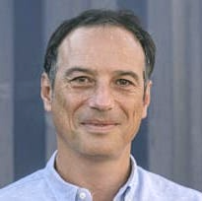
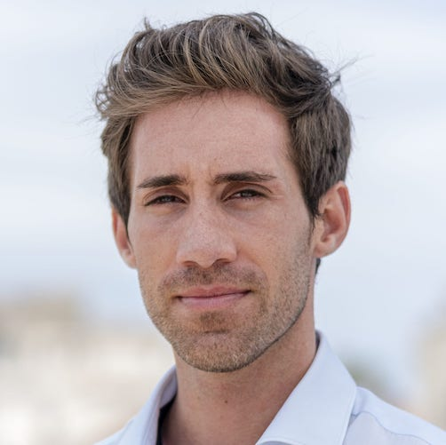

Sustainability: Shipyards, bio fuel
& solutions​
Vincent Escallier
MB92 Group
Business development Director
Marc Hervás
MB92 Group
Sustainability Manager
ECPY Riviera Yachting Symposium
18 June 2025​

Slide 2

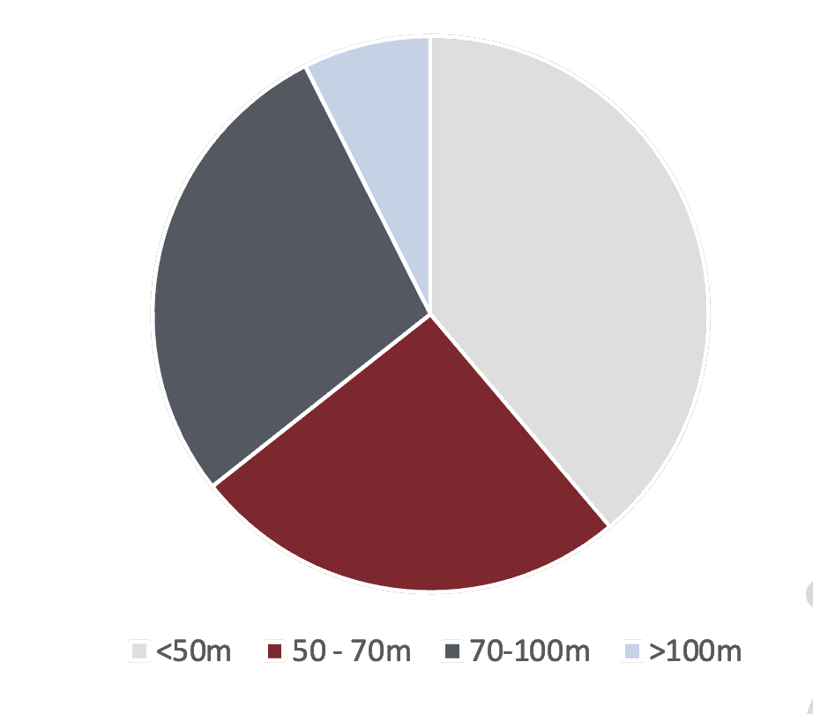
MB92 Barcelona
MB92 La Ciotat
MB92 Golfe-Juan
MB92 Red Sea
Projects by length
188
Projects completed 2024
73
Number of projects under 50m LOA
2

Slide 3






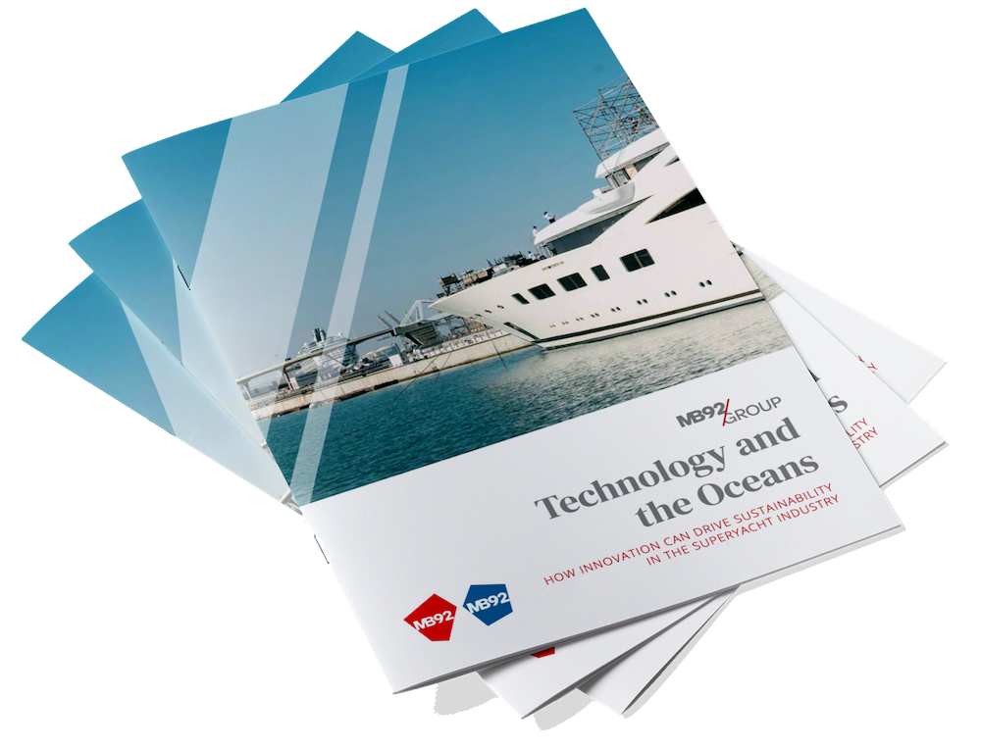
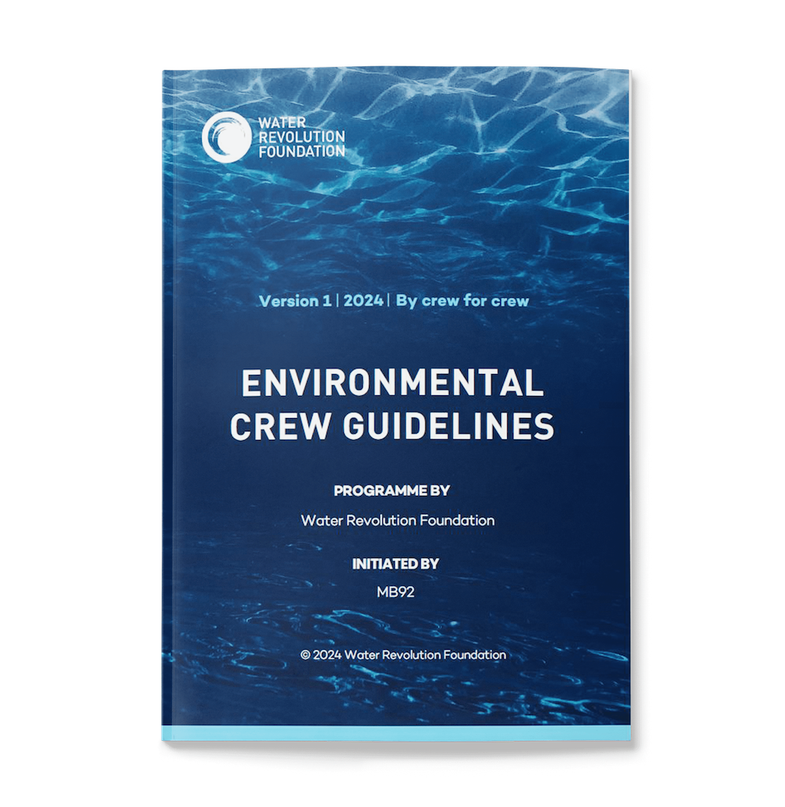



Our core sustainability objectives
1
SHIPYARD OPERATIONS
Improve the sustainability of our activity
Refit for the Future!
2
SOLUTIONS FOR THE FLEET
Accompany our clients in reducing their impact on the environment
Short-term
Improvement plan
Medium-term
Optimisation plan
Long-term
Conversion plan
COMMUNITY & PARTNERSHIPS
Driving our industry towards a sustainable future
3
3

Slide 4
How a refit impacts
the environment
WATER QUALITY AND USAGE
Water scarcity, wastewater and contamination
Covering for outdoor paintworks (ca. 50% of refit yards don’t use this properly or at all)
Water treatment systems
Drone monitoring, collecting/absorbing spills
Nature based filtration and quality monitoring
Fish nurseries
Full circular water treatment
VOCs REDUCTION (PAINTWORKS)
Worker safety and emissions
Implemented filters and VOC monitoring software
Ionization system to scrub VOCs from air in tents
Dedicated paint centres
ENERGY EFFICIENCY AND TRANSITION
E.g. Energy consumption from docked yachts and shipyard
Electrified docks with all vessels provided shore power
Solar panels
ISO50001 energy mgmt. system
Efficiency with new tech, e.g. electric heating during painting
Use of HVO, substitution of old equipment & vehicles
WASTE MANAGEMENT AND CIRCULAR ECONOMY
Plastic and toxic waste
Implemented methods for reusing and recycling plastic protection and shoe covers.
Hazardous waste fully covered (dedicated person)
4

Slide 5
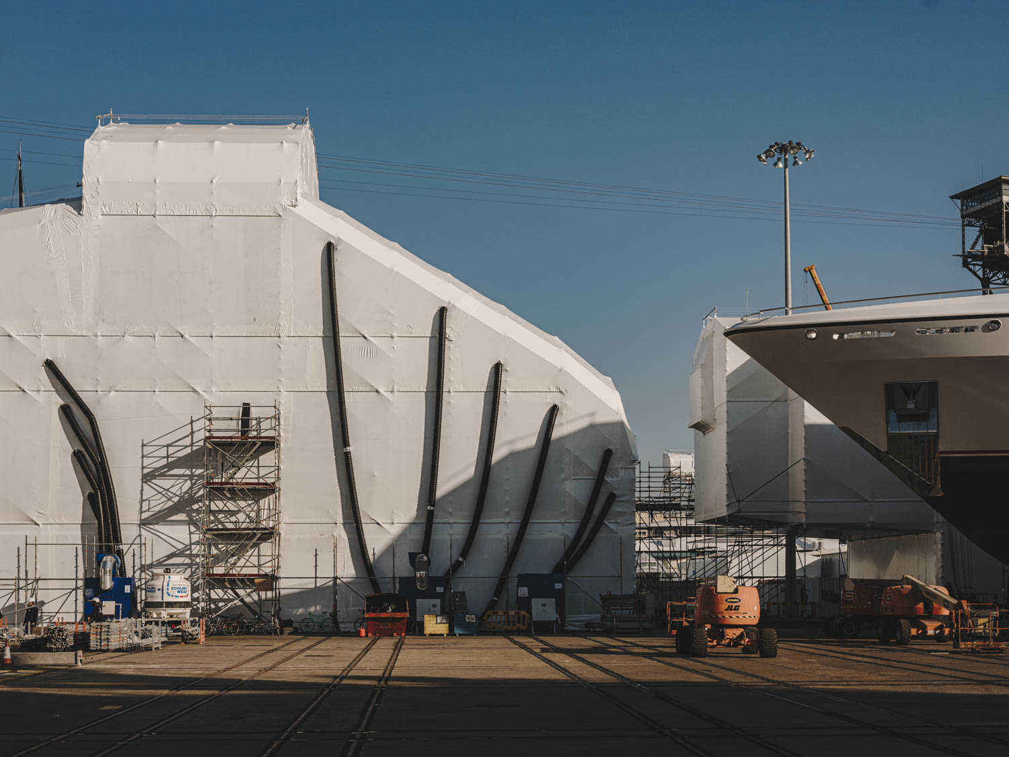
Initiative A
Reduce VOCs
  Innovative filtration system
  Powered by 100% renewable energy
  22,000kg VOCs generated before
  97.1% VOC reduction after
  Dedicated fittings centre
5

Slide 6
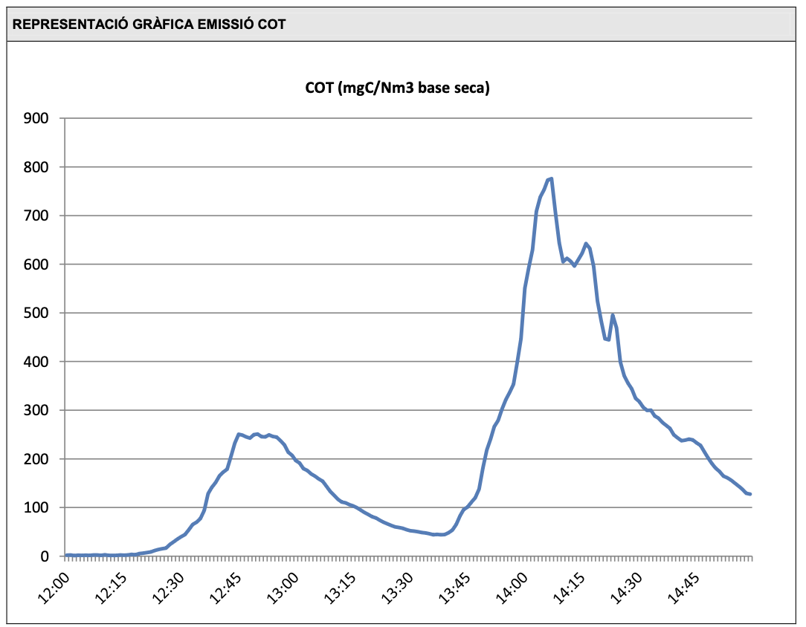
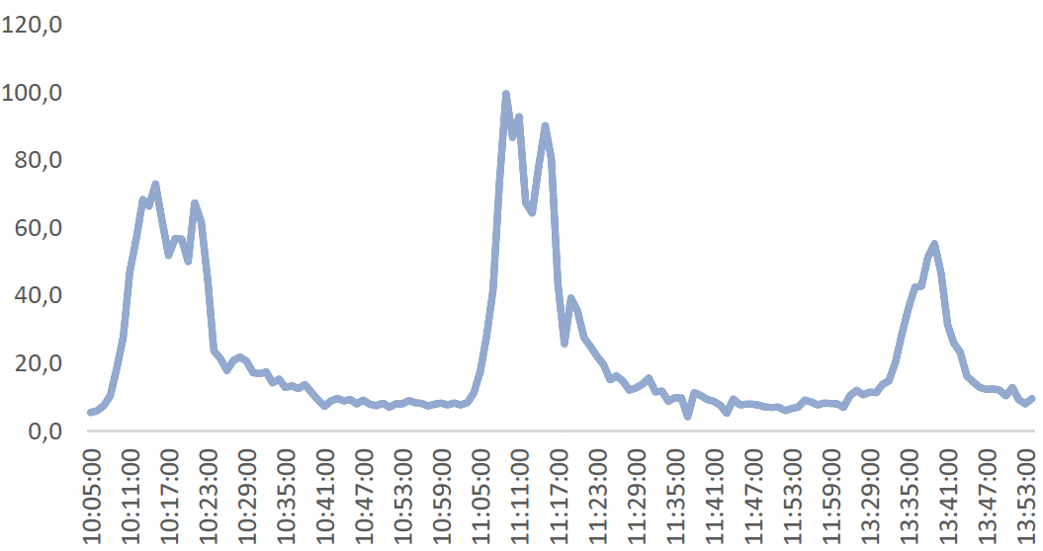
TRADITIONAL ACTIVE CARBON DRY FILTER
Benefits of a gas
washer filtering system
  VOC emission compliance. Directive 2010/75/EU on industrial emissions. Filters >97% of solid particles and VOC.
  Meets directive 2014/34/EU related to equipment intended for use in potentially explosive atmospheres.
  Easy installation and use. Continuous unattended operation.
  Low waste impact. No solid filters.
  Scalable
  Real time monitoring consumption.
VLE = 75 mgC/Nm³
Avg: 207 mgC/Nm³
WASHER
Coat 2
Coat 1
Coat 3
VLE = 75 mgC/Nm³
Official avg. concentration:
23 mgC/Nm³
6

Slide 7
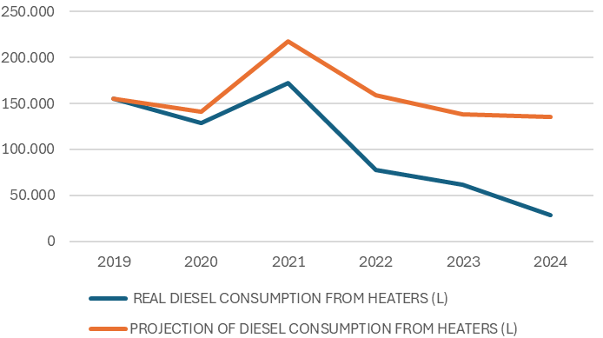
DIESEL CONSUMPTION FROM HEATERS
Initiative B
Heating systems &
energy transfer
  Transfer from diesel to alternative systems
  100% renewable energy sources
  Automisation and remote monitoring
YEAR | REAL DIESEL CONSUMPTION FROM HEATERS (L) | PROJECTION OF DIESEL CONSUMPTION FROM HEATERS (L) | % REDUCTION L/GT*DAY COMPARED TO 2019
2019 | 155.542 | 155.542
2020 | 129.011 | 141.333 | 9%
2021 | 171.937 | 217.343 | 21%
2022 | 77.589 | 159.414 | 51%
2023 | 61.716 | 138.608 | 55%
2024 | 28.554 | 135.196 | 79%
7

Slide 8
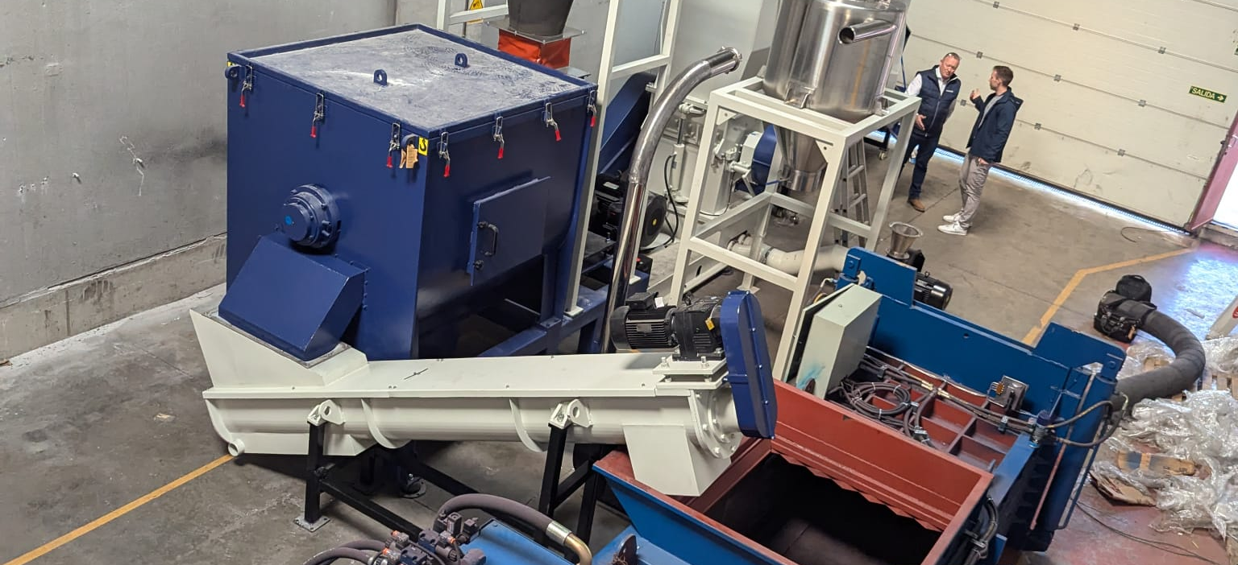
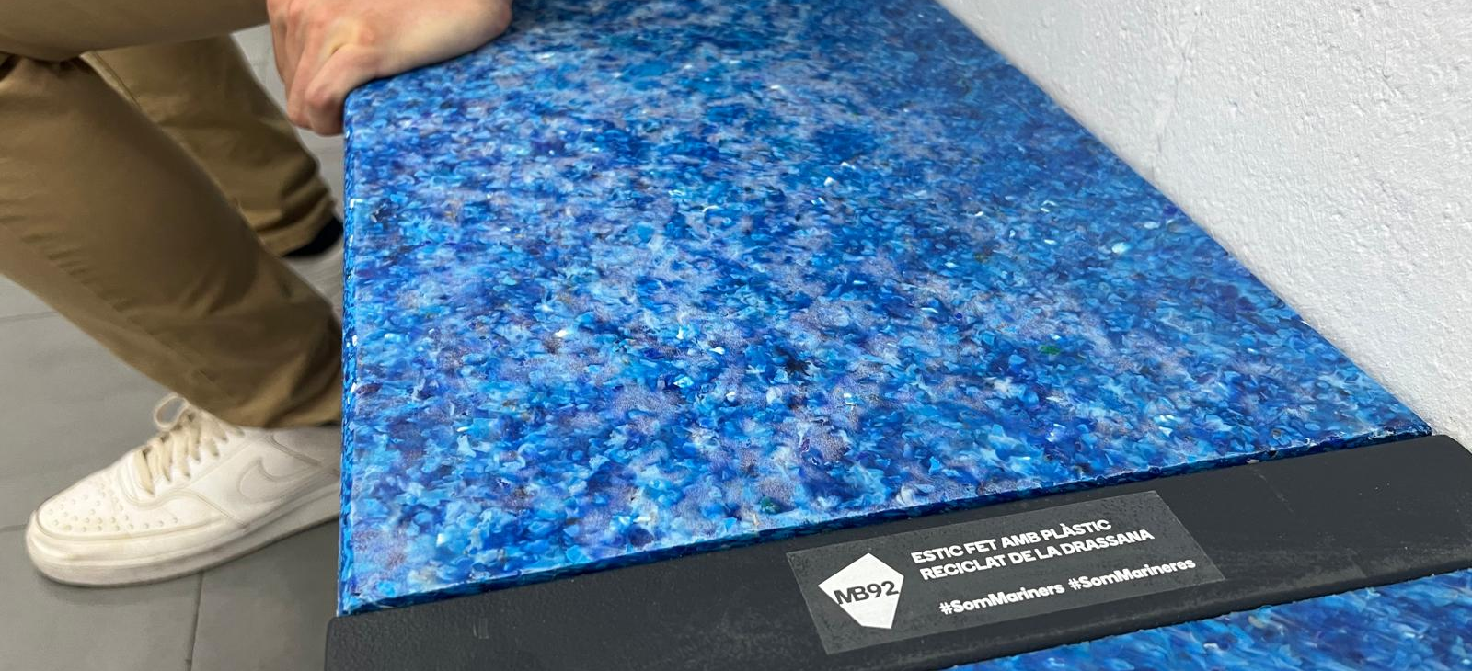
Initiative C
Plastic waste
management
  Collaborative project
  Responsible cleaning method
  Capacity to process approx. 200 tonnes of plastic per year
  Community initiatives
8

Slide 9
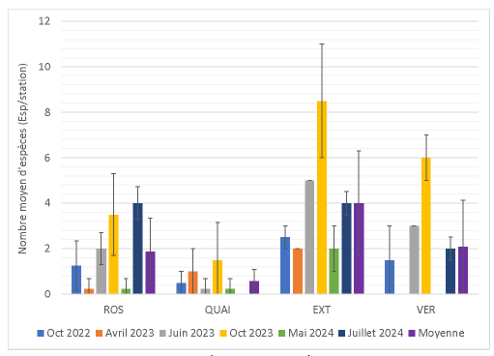
Positive Impact of Reed Beds on Juvenile Species Diversity
Initiative D
Improve port biodiversity:
Fish Nurseries
  Enhancing biodiversity in port environments by encouraging the presence of marine life.
  Supporting the development of juvenile fish populations through the creation of sheltered, structured habitats.
  Promoting natural colonisation by benthic organisms, contributing to a richer marine ecosystem.
  Regular testing and evaluation of the effectiveness of the nurseries.
  Long-term ecological regeneration in areas impacted by port activity and infrastructure.
9

Slide 10
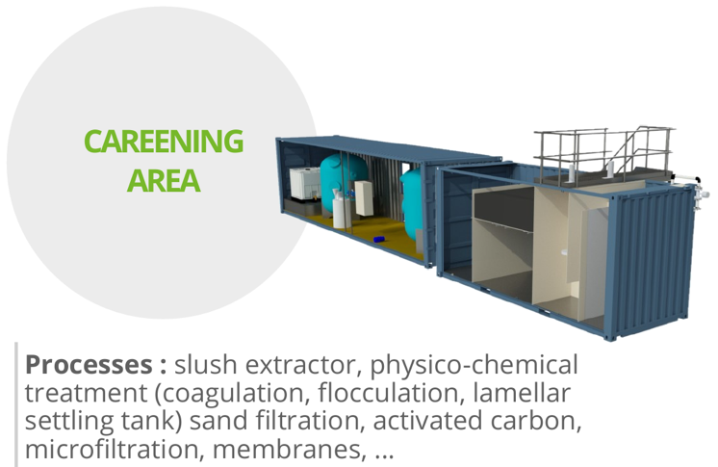

NOMADO WASTEWATER TREATMENT PLANTS IN LA CIOTAT
Initiative E
Water treatment facilities
Recycling and reuse of waters
Reduced reagent consumption
Adapted and scaleable system
  Mobile and modular unit
  Easy to adapt depending on variations (flow and charge)
Same system being installed this summer in Golfe-Juan
10

Slide 11
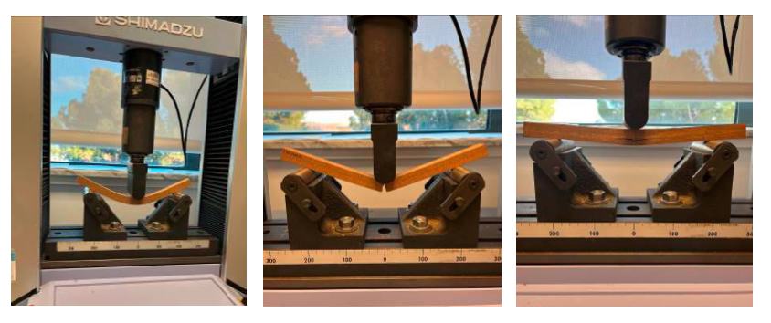
Determination of static bending strength
Initiative F
Teak study
Identify eco-friendlier alternatives that meet yachting standards for durability, stability, and aesthetic appeal.
Study undertaken in partnership with Kreative decks to assess physical and chemical performance of various teak options.
6 teak types tested, including:
  Cork teak (composite-based sustainable material)
  Indonesian plantation teak
  Traditional Burmese-style teak (TE-1 to TE-4)
Key Findings
🪵 TE-2 (traditional teak) showed best flexibility and resistance after ageing.
🧩 Cork teak was lightest and made from sustainable materials, but performed poorly in durability and stability tests.
🌿 Indonesian teak (TE-6) demonstrated the best overall dimensional stability, making it a strong alternative to old-growth teak.
11

Slide 12
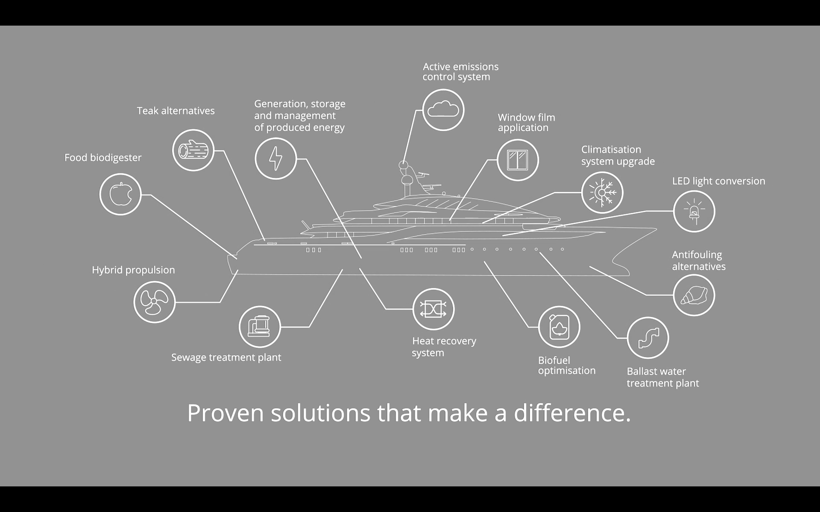
Sustainability is also an opportunity for our industry…

Slide 13
Sustainability: Shipyards, bio fuel & solutions​
Vincent Escallier
MB92 Group
Business development Director
Marc Hervás
MB92 Group
Sustainability Manager
ECPY Riviera Yachting Symposium
18 June 2025​

