Slide 1
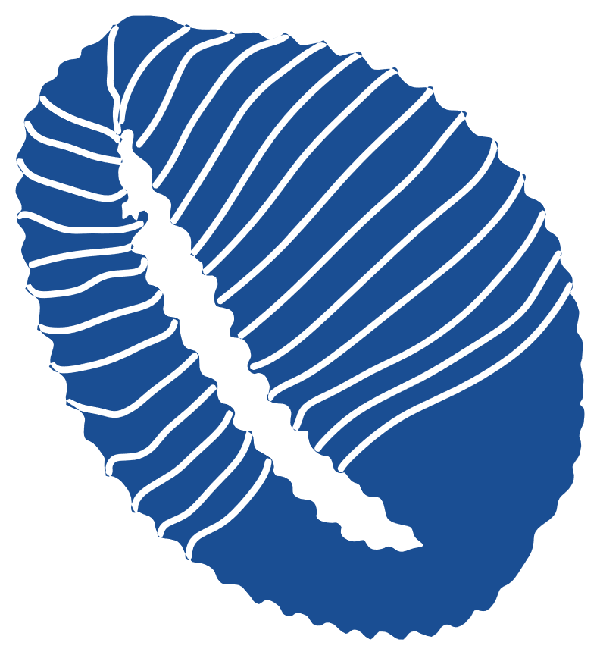
Yacht mooring in the Mediterranean Sea
A technical perspective
1

Slide 2
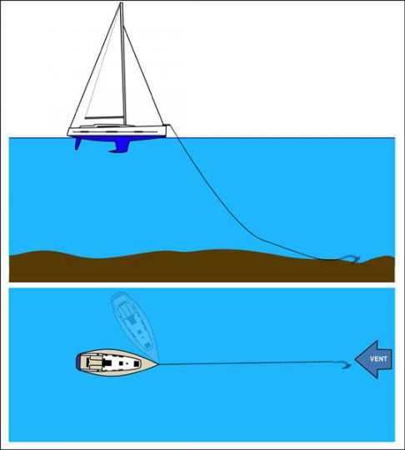
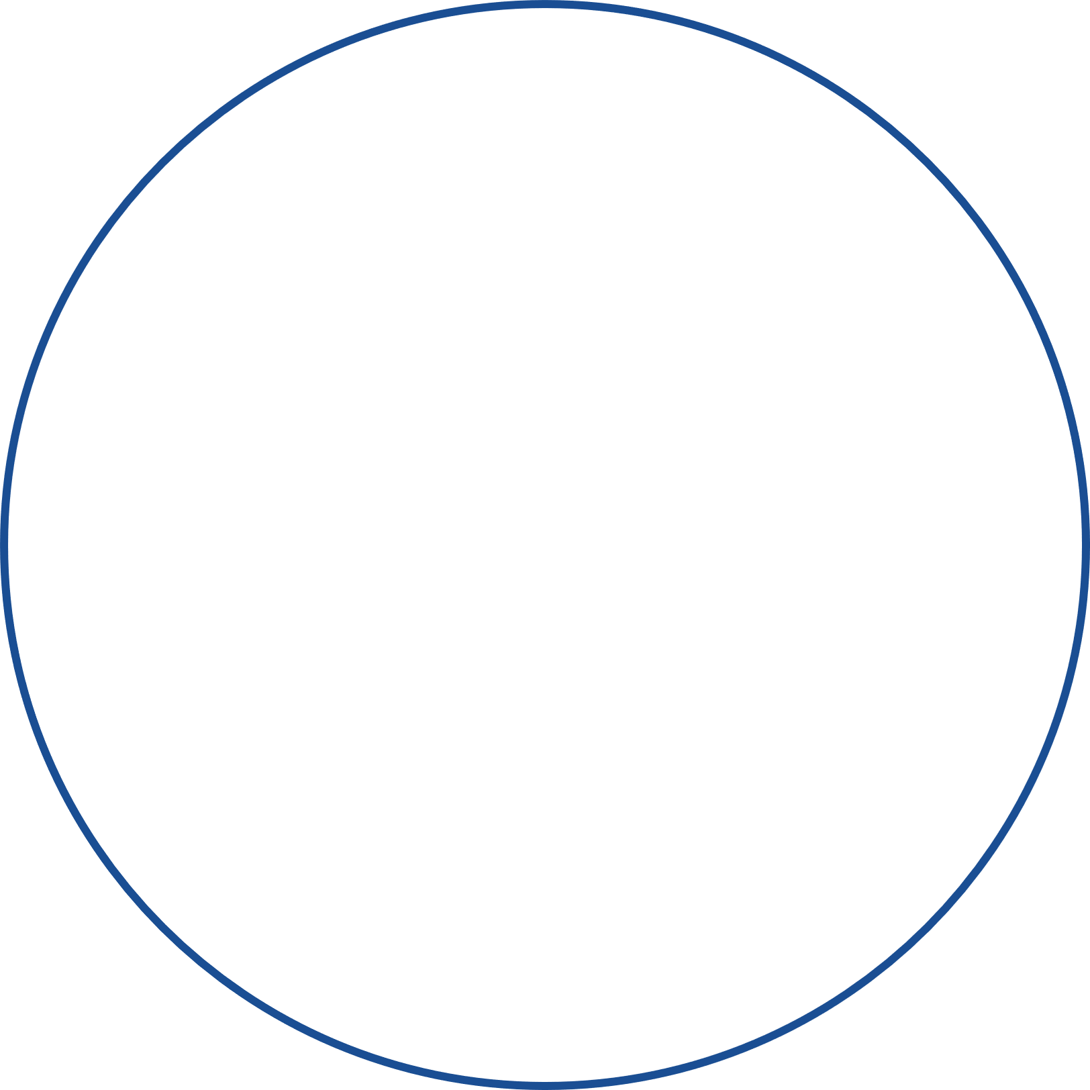
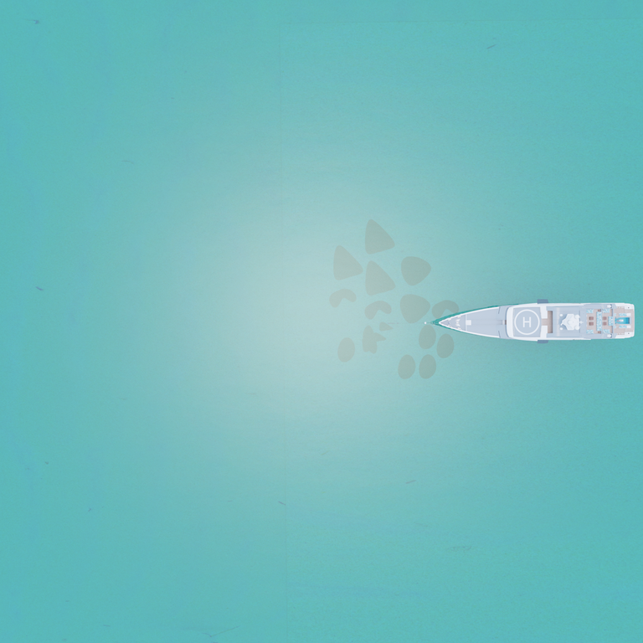


Classical mooring with chain
Comparaison of 2 swing radius
Swing radius with chain mooring
steel chain = holding strenght
Swing radius with elasto-textile mooring
chain weight = damping effect
weight keeps
anchor horizontal
Chain = strenght + energy absoption with weight
Big radius = heavy cost
2

Slide 3
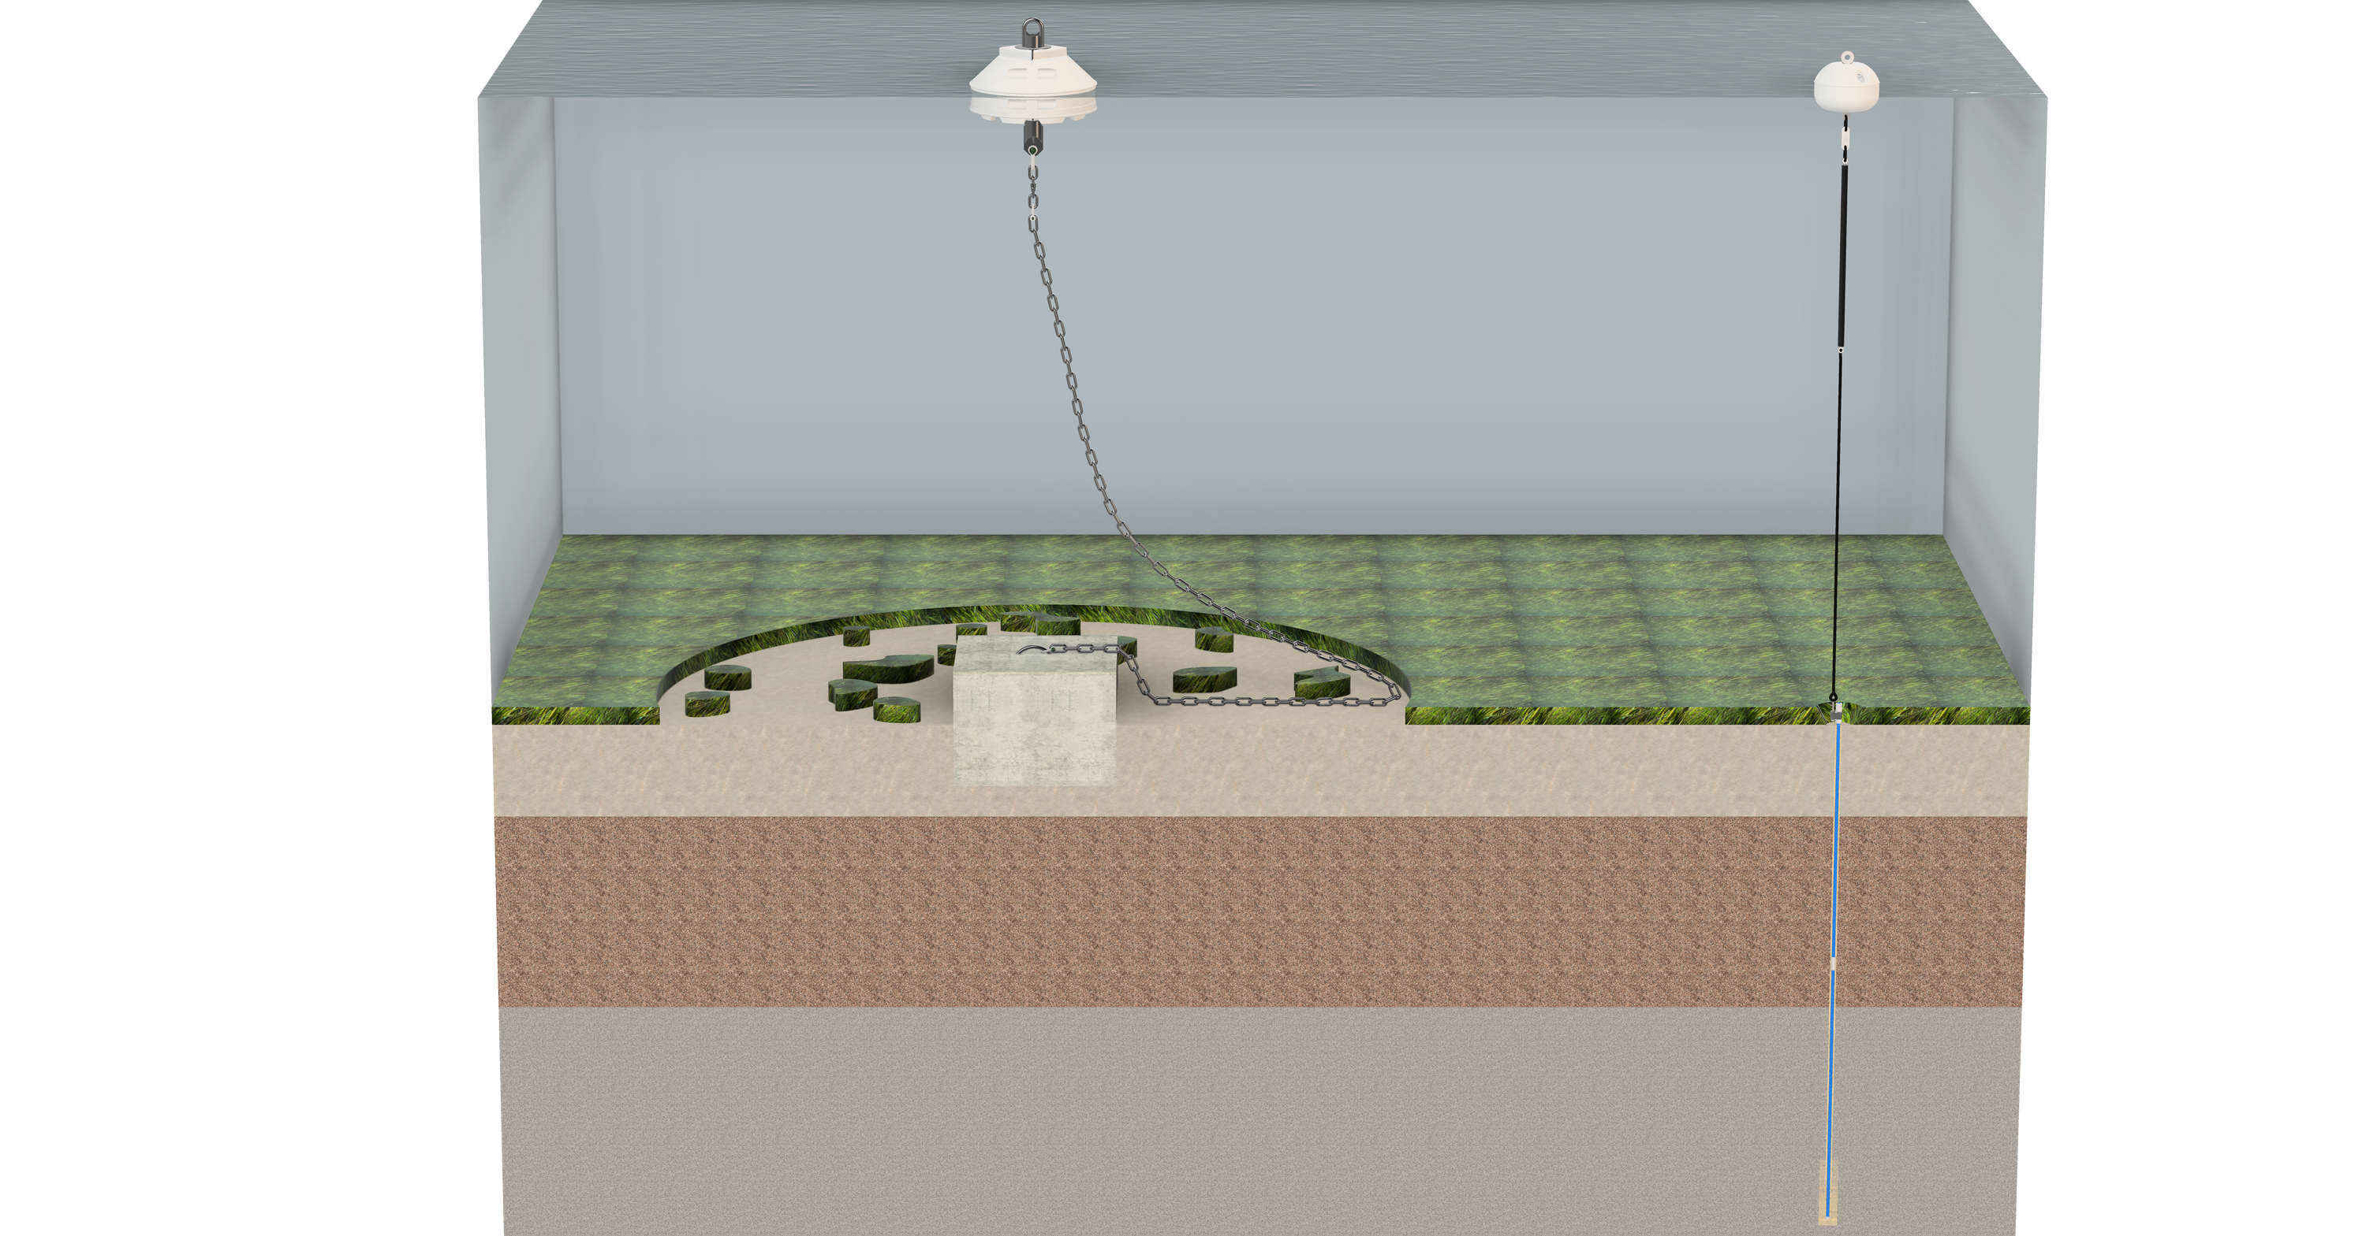
VS
Traditional mooring
TEMANO® mooring
Temano®
Buoy
Temano®
Schock absorber
Textile line
Temano®
Anchor
3

Slide 4

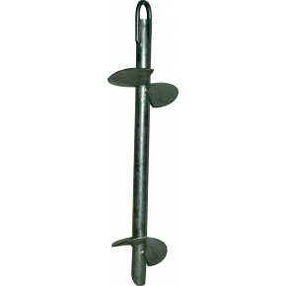
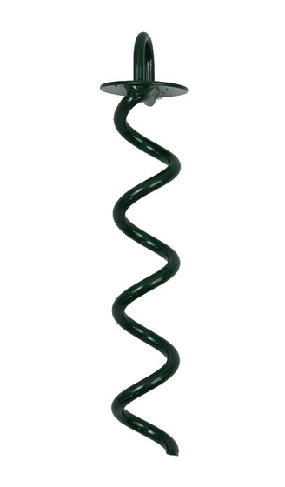
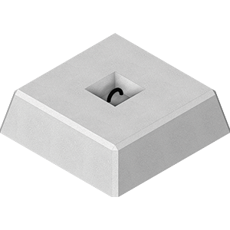
Anchor : fixed point on the seabed
For bigger boat like
Yachts → drilled anchors
Benefits :
  Low footprint and Big load resistance
  Works on all types of seabed
  Customised top end fitting
Concrete block
Big footprint and big load resistance
Screw anchor
Helical anchor
Low footprint and low load resistance
(for specific seabeds only)
Temano®
drilled anchor
Great for light boats !
4

Slide 5
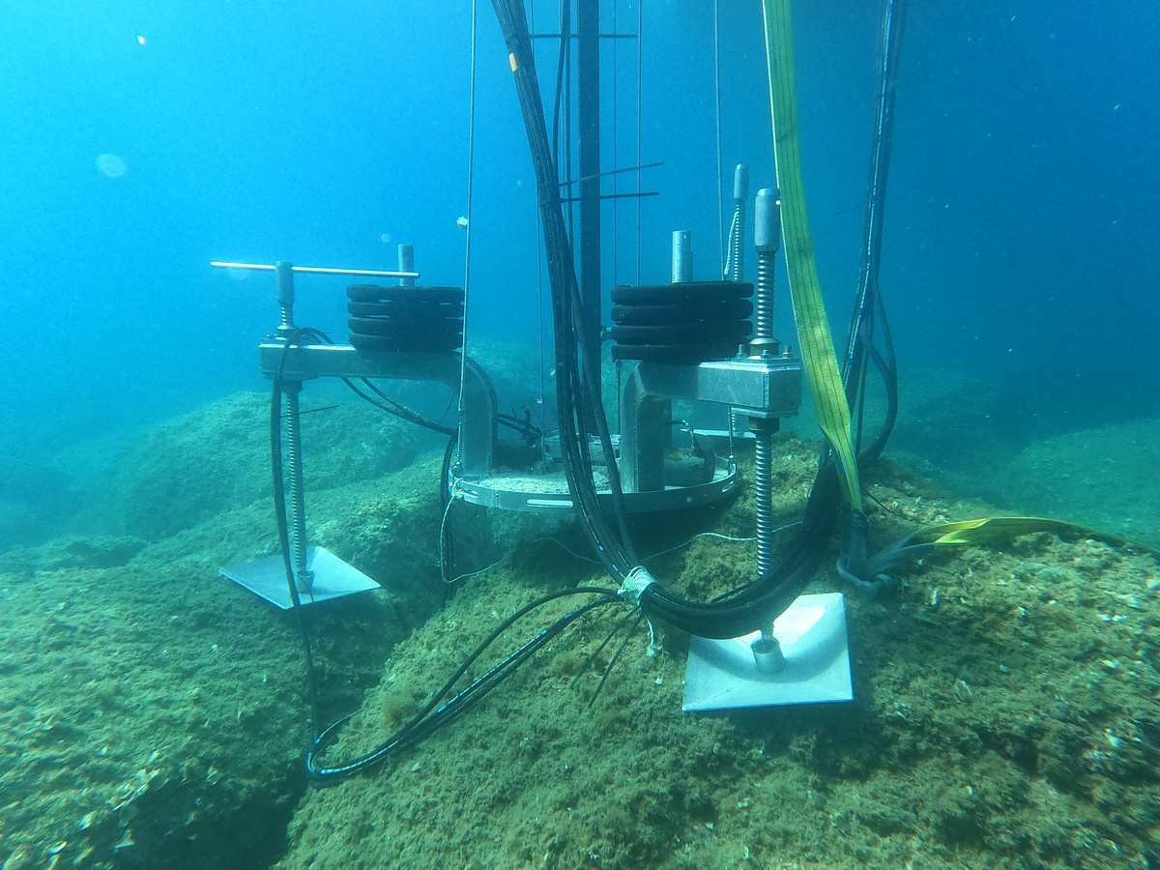
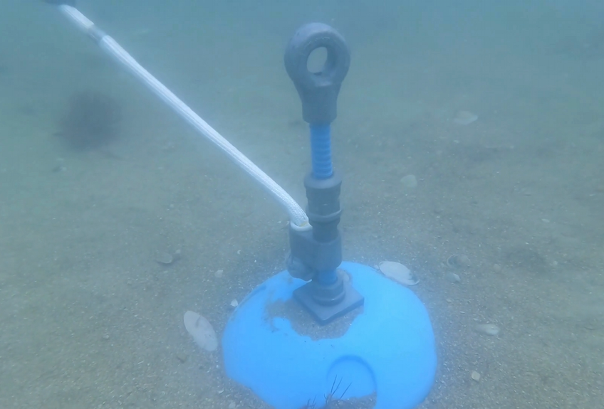
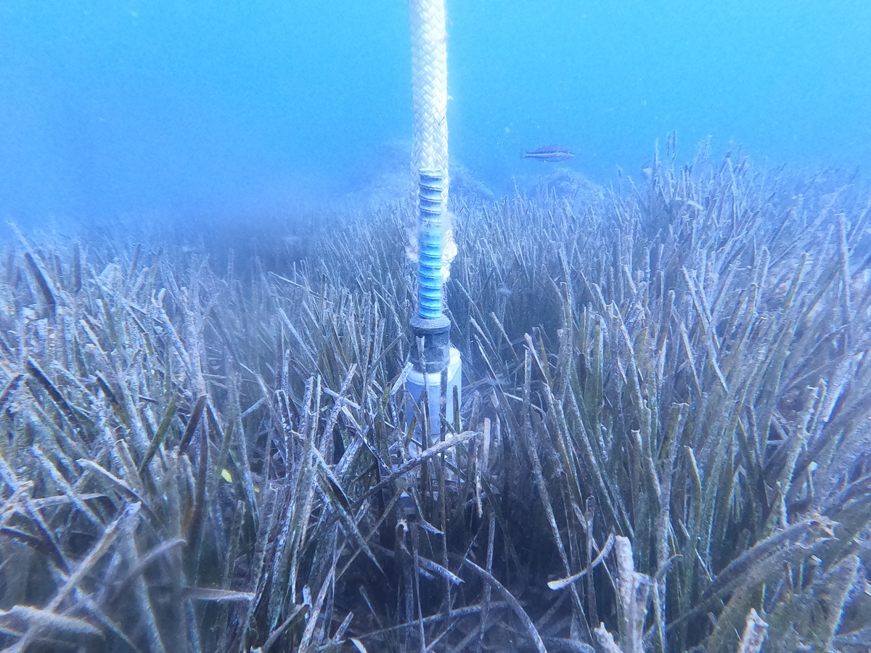
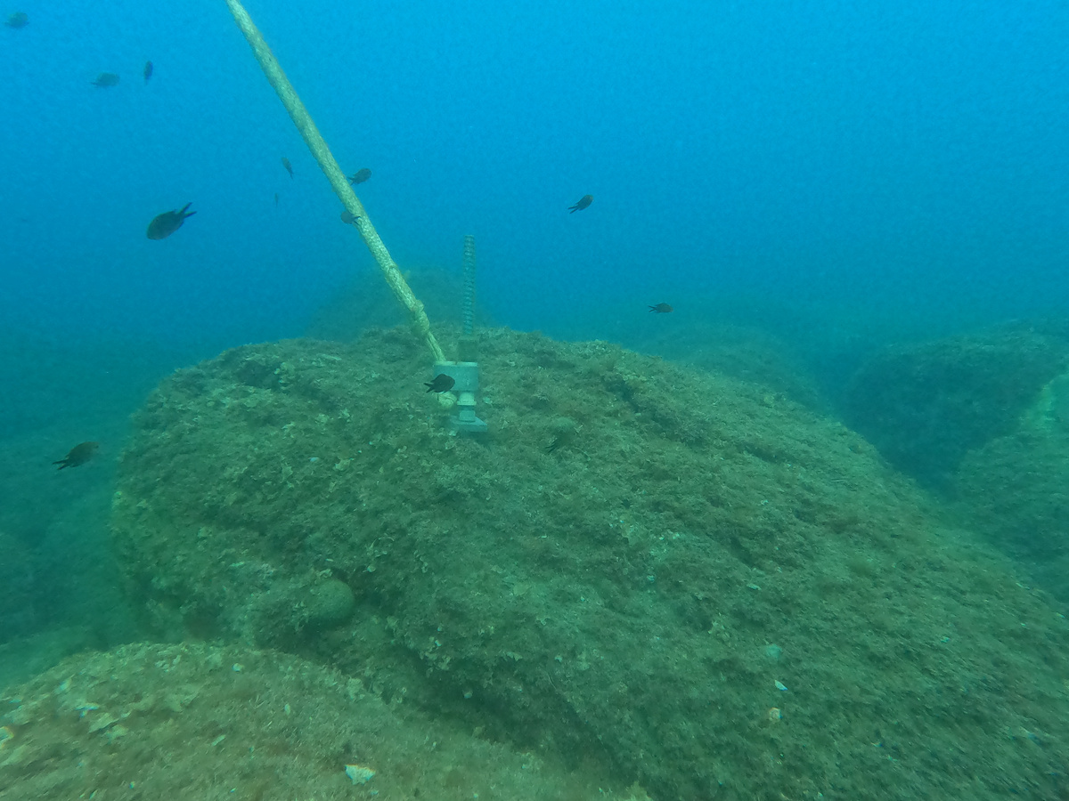
Temano® anchor
Effective on any seabed.
Reduces impact on the seabed
Anchoring machine
Anchor set on sand
Anchor set on rocks
5
Anchor set on seagrass

Slide 6
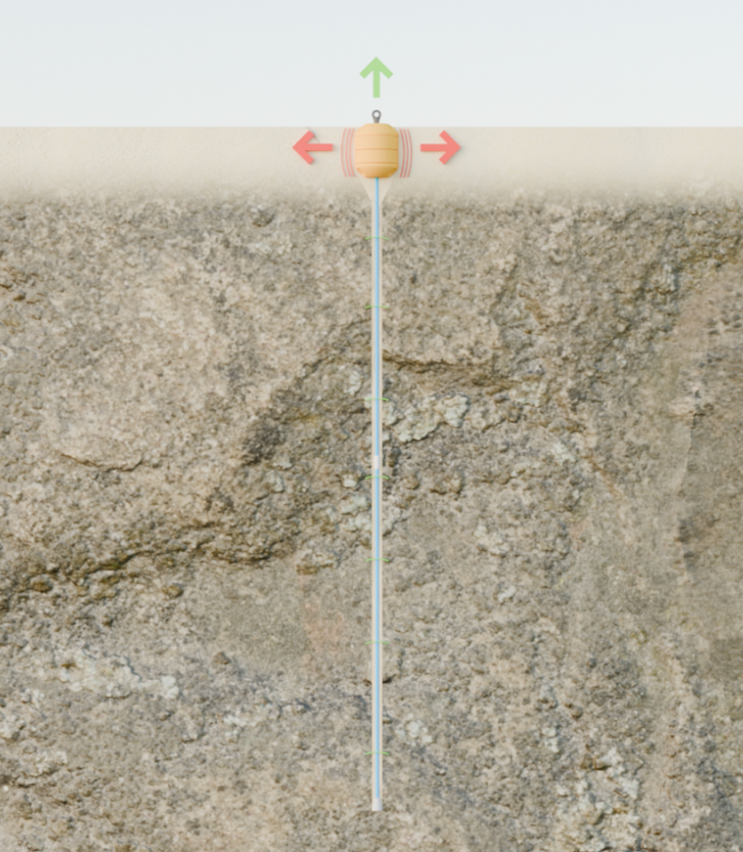
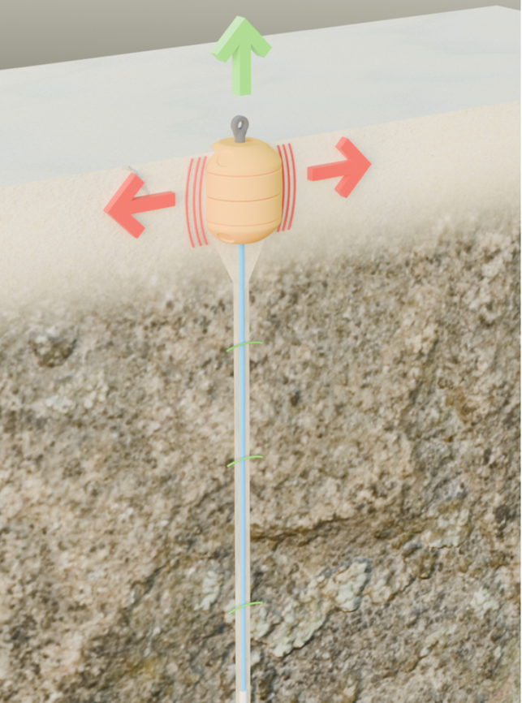
Temano® anchor
6

Slide 7
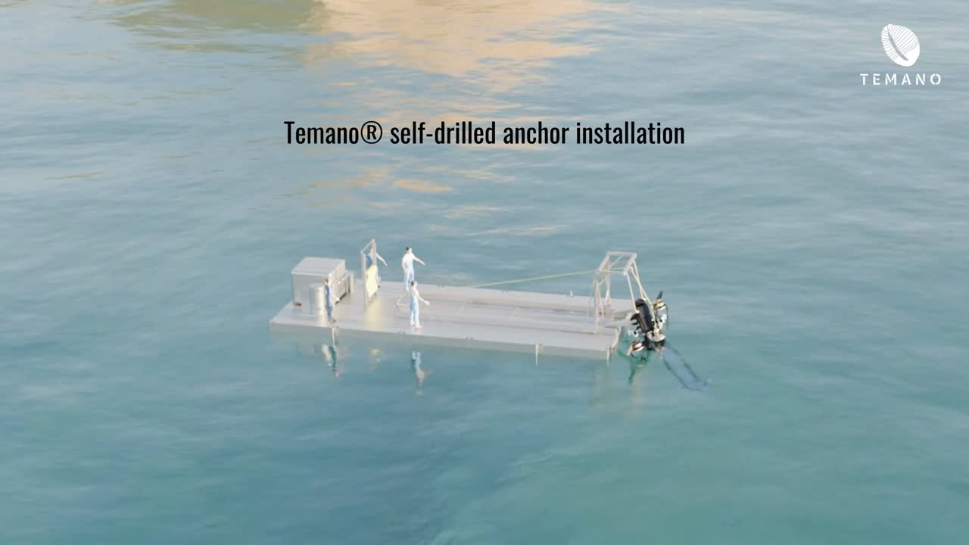
Temano® anchor
7

Slide 8
Mooring line
Textile alone = not safe because lack of damping effect
Why is damping required ?
8

Slide 9
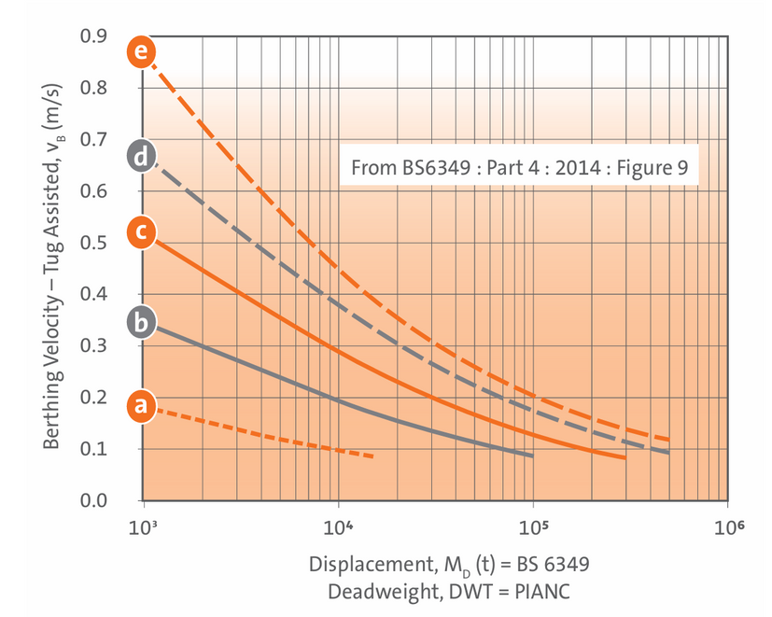
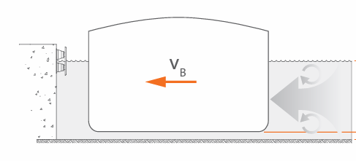
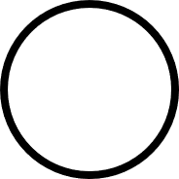
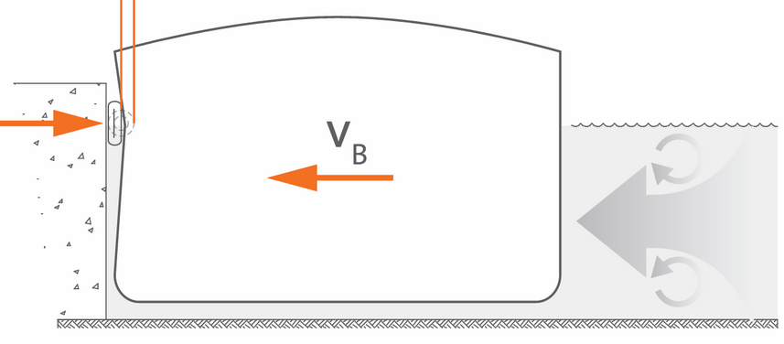

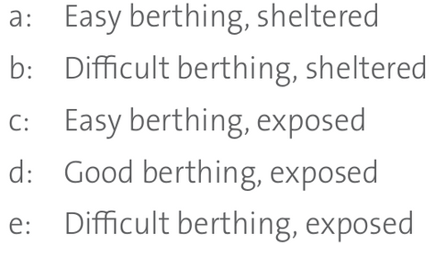
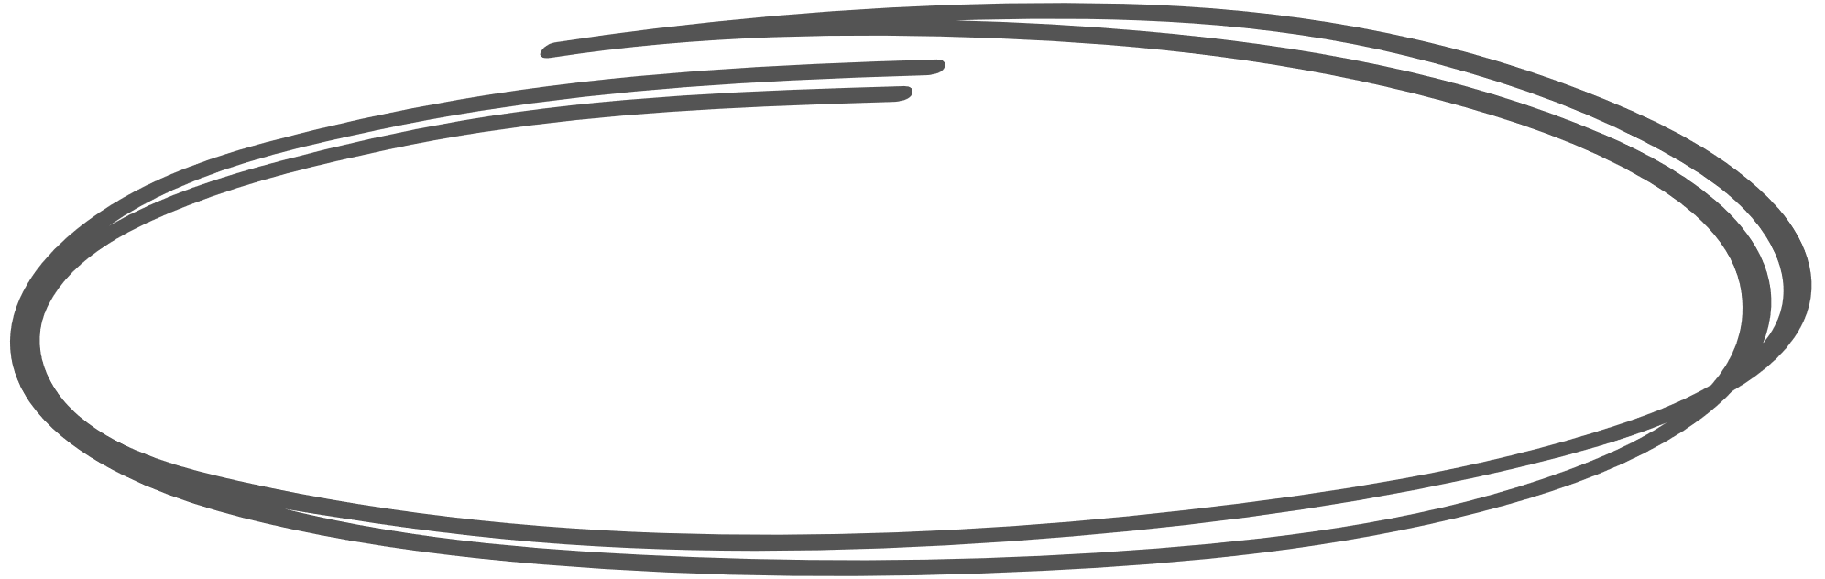
When docking alongside...
Docking speed
Energy damper
0.5 m/s
Soft berthing
Energy charged damper
1000 T
Ship at rest
9

Slide 10
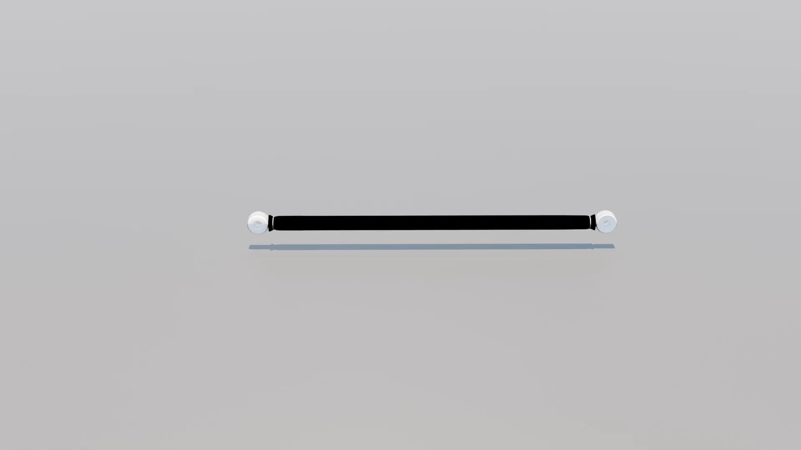
The mooring line needs strenght and damping
 | Strenght | Damping
Chain
Elasto-textile line
Steel
Weight
Textile
Natural rubber
10

Slide 11
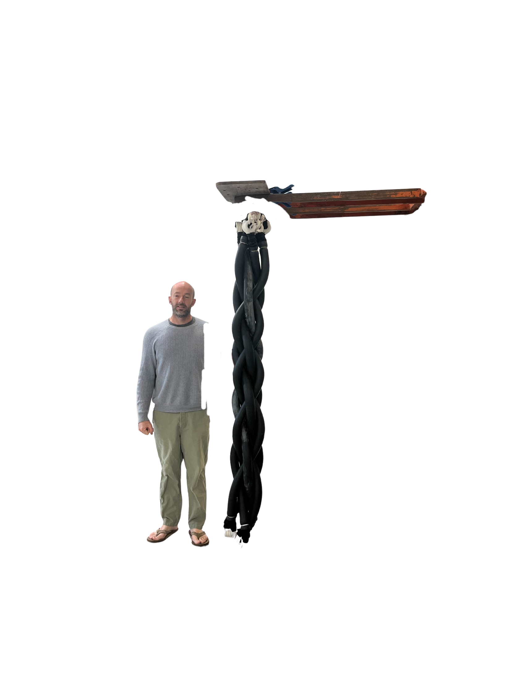
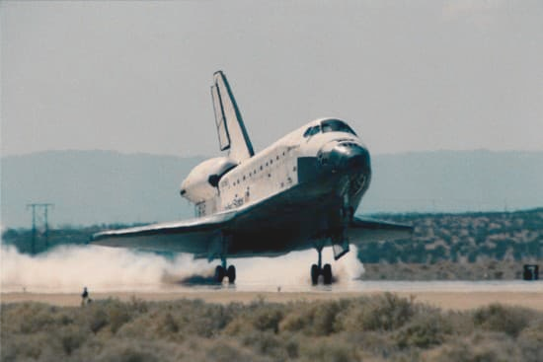

Temano® schock absorber
40m yacht shock absorber
Natural rubber
11

Slide 12
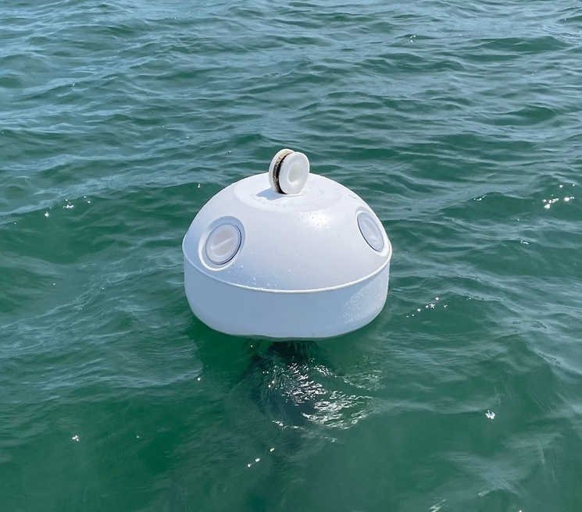
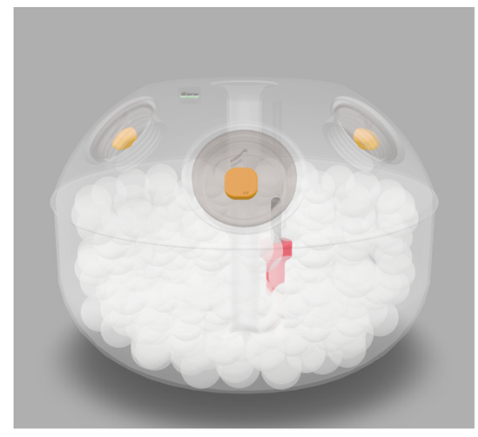
Temano® Yachting Buoy
As small as possible but big enough !
“Smart” Buoy :
  Safety buoyancy balls
  AIS
  Directional lights with low impact on wildlife
  Connected buoy (GSM or satellite communication)
150L
700x500 mm
12

Slide 13
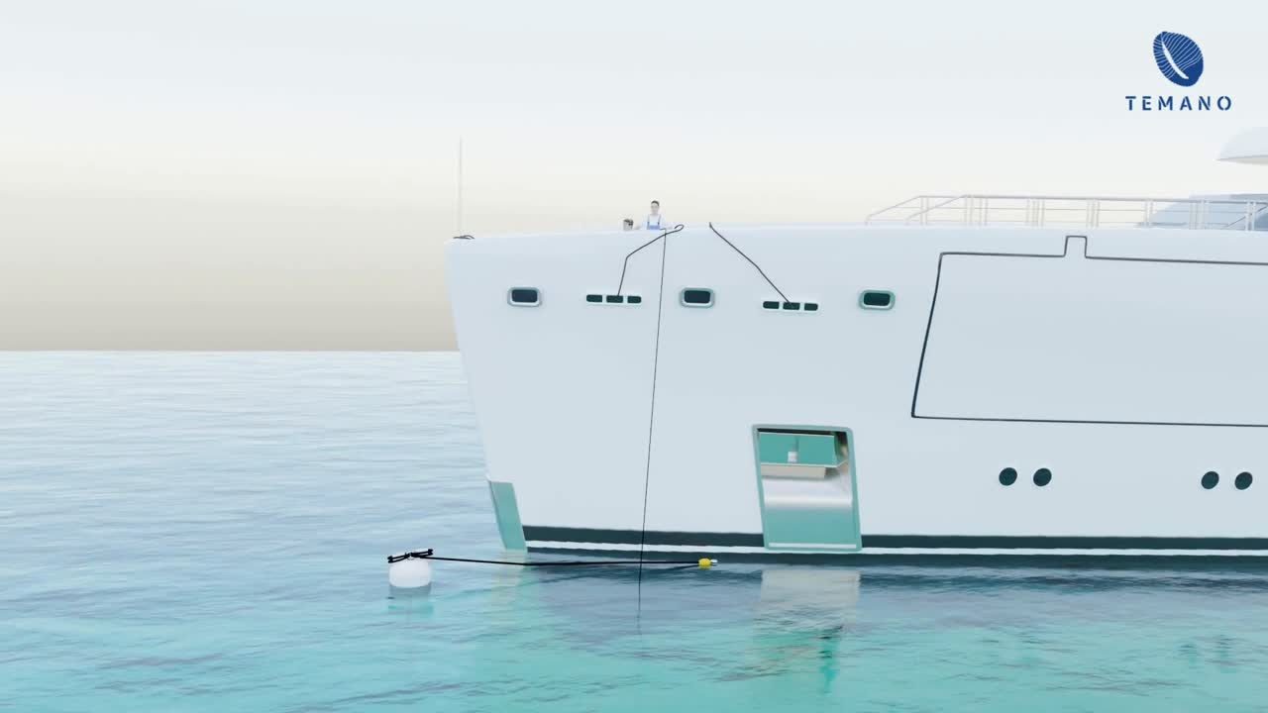
Grabing mooring line
with hook from foredeck area
13

Slide 14
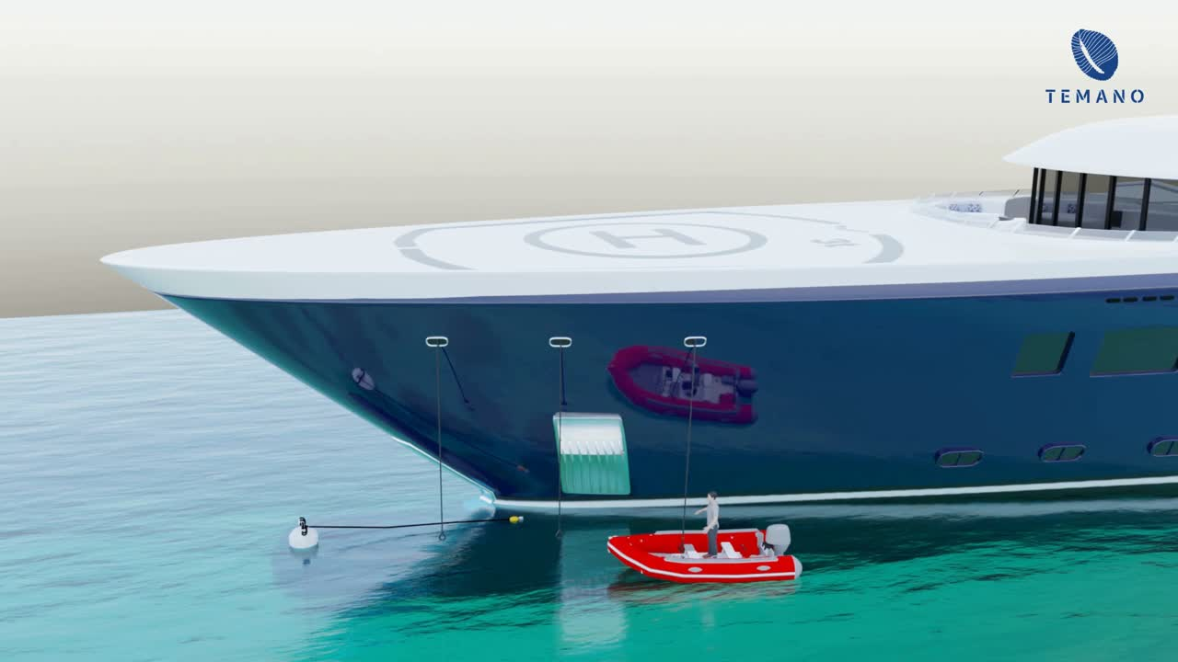
Grabing mooring line with a tender
14

Slide 15
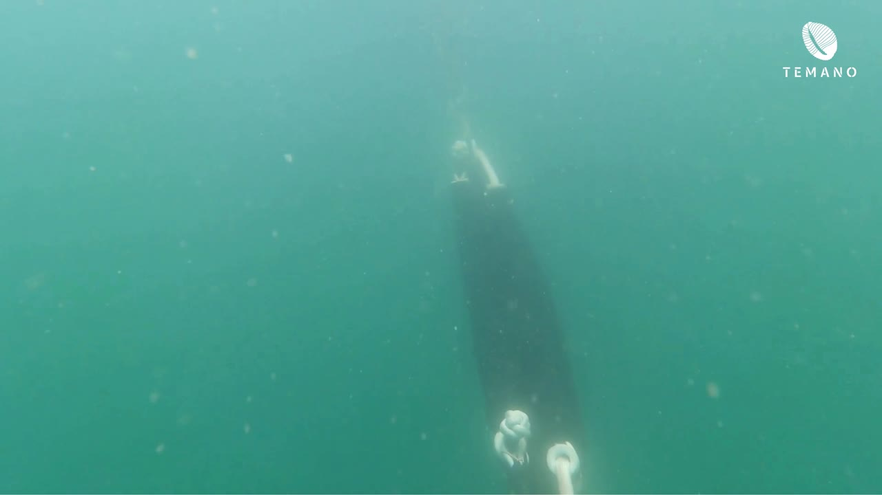
Natura 2000 mooring :
120 tons passenger vessel in South Britanny
15

Slide 16
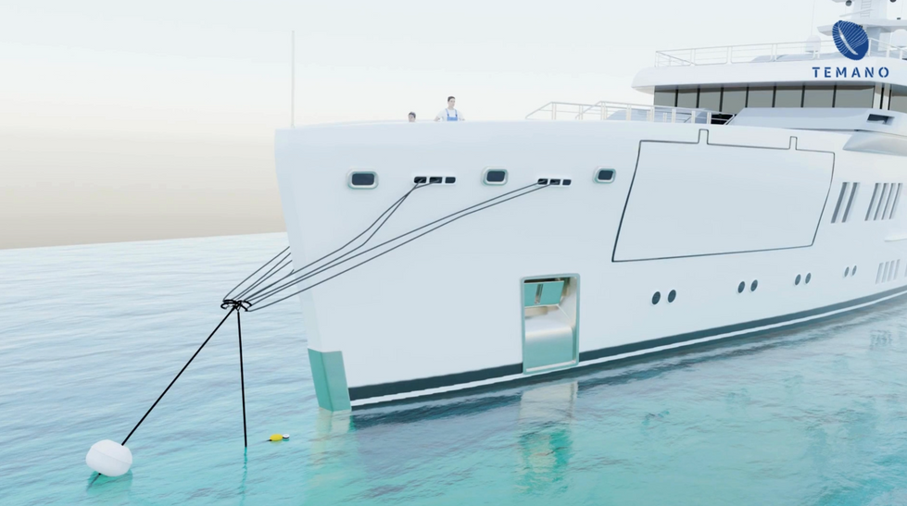
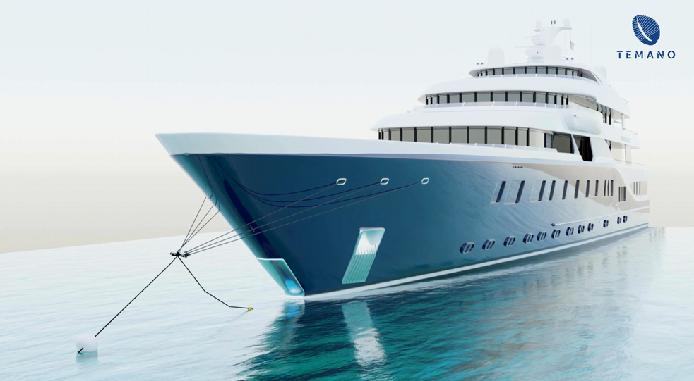
Two examples
Weather condition :
Beaufort scale force 8
  Wind speed : 20m/s
  Currents : 0.5m/s
  Waves : 2m
M/Y Elysian :
  lenght: 66 m
  weight : 1527 T
  6 strand of 6m shock absorber
  Max load : 50kN = One Temano® Anchor
  720 kJ
  Max drift speed : 0.97 m/s
M/Y Symphony :
  lenght: 100m
  weight : 3 000 T
  12 strand of 6m shock absorber
  Max load : 146 kN = One Temano® Anchor
  1440 kJ
  Max drift speed : 0.98 m/s
16

Slide 17
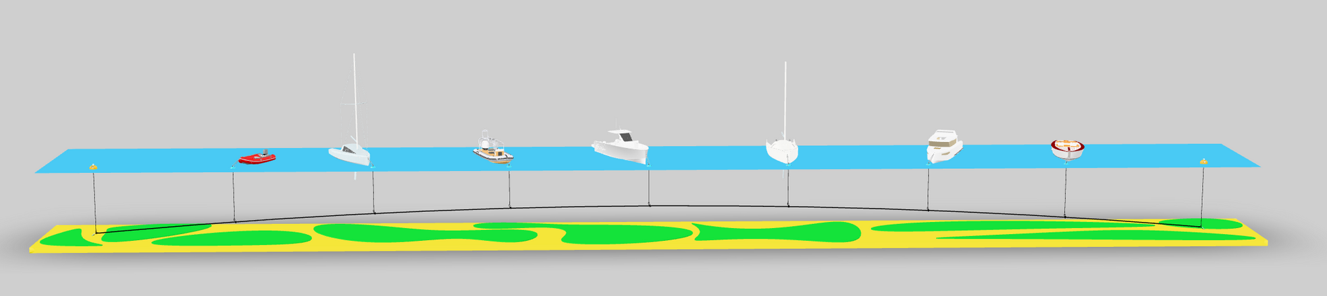
Temano® mooring costs
66m M/Y Elysian
Mooring cost : from 34 000€
105m M/Y Symphony
Mooring cost : from 56 000€
7m boats on a floating line mooring
Mooring cost : from 2 000€
17

Slide 18
Boat size | Mooring price (from...)
under 7m | ... 2 000€
7 to 15m | ... 3 800€
15 to 24m | ... 6 200€
24 to 40m | ... 15 300€
40 to 80m | ... 34 000€
80 to 120m | ... 60 000€
18

Slide 19
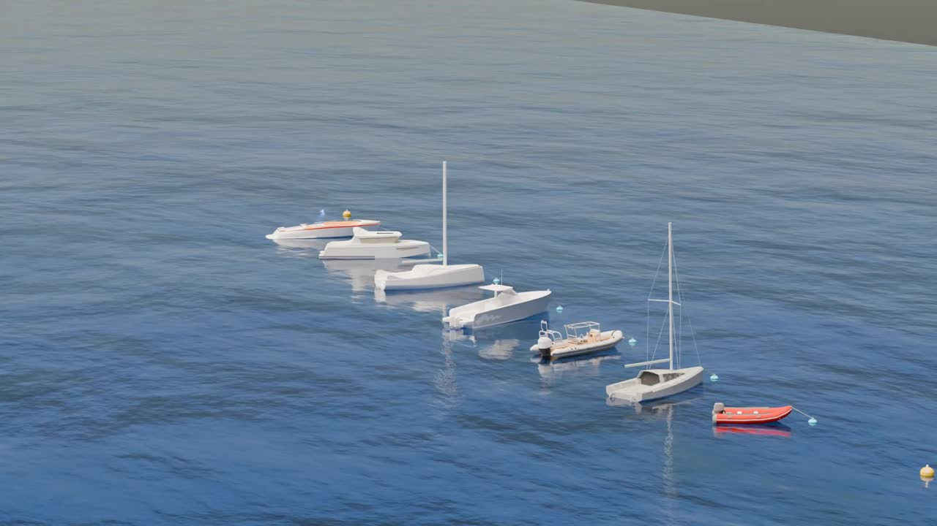
19

Slide 20
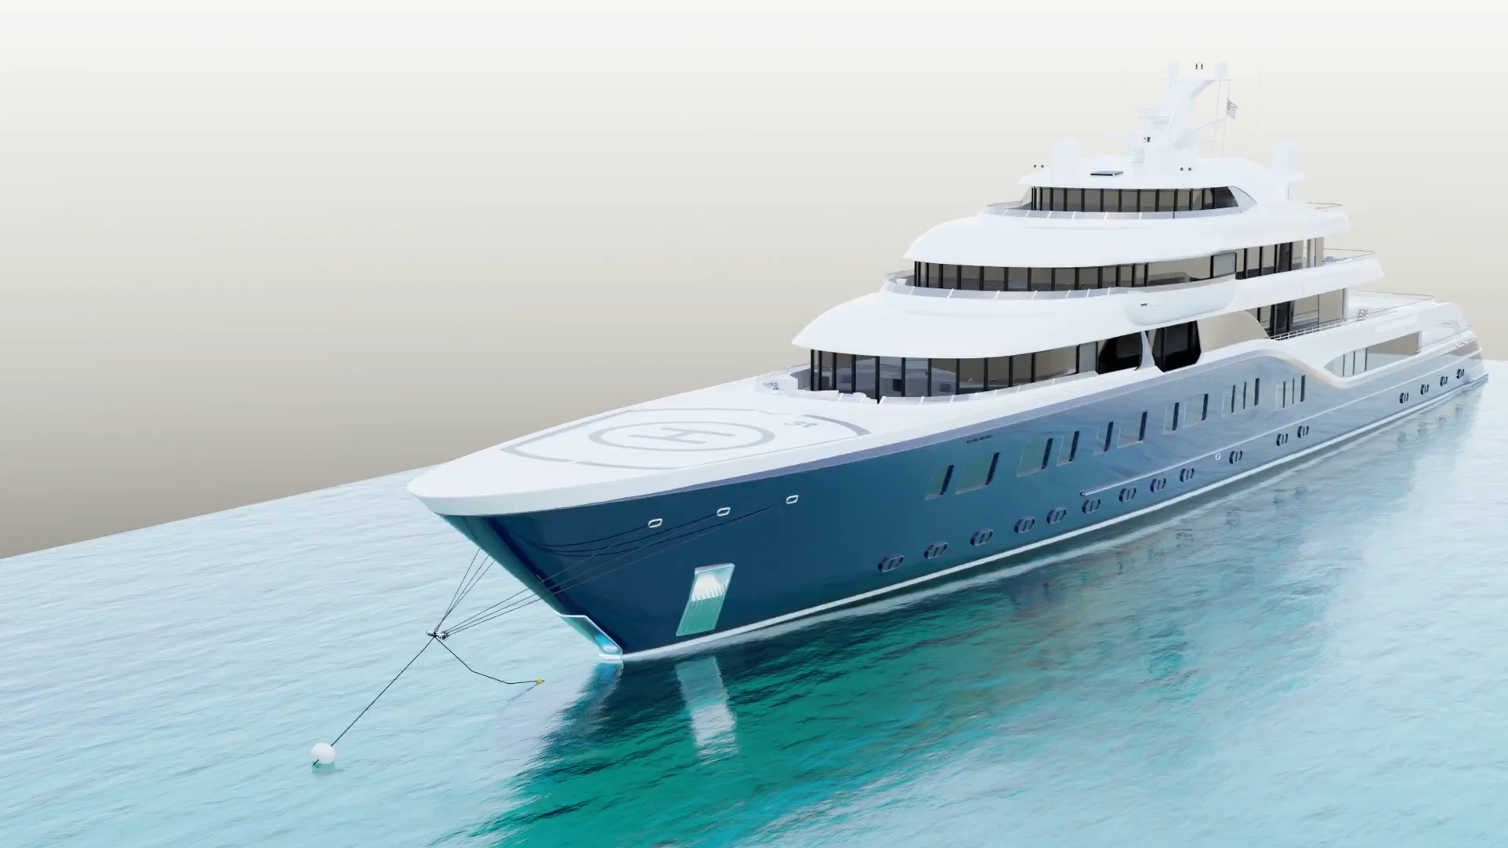
20

Slide 21
Yacht mooring in the Mediterranean Sea
A technical perspective
21

